Slide 1

































Microsoft Azure Data Analytics Platform アーキテクチャ
Generate
Ingest
Store
Process
Enrich
Serve
Consume
On-Prems / Cloud
Realtime
Stream
Hot Path
IoT Hub
Batch
Functions
Dashboard
Event Hubs
Stream Analytics
Cognitive Services
SQL Database
Analytics
Machine Learning
Cold Path
Cosmos DB
Data-driven Applications
NoSQL
HTAP with Synapse Link
Data Lake
Data Share
Shared Datasets
Discover & Govern
Azure Purview
Azure Active Directory
Azure Cost Management
Azure Key Vault
Azure Security Center
Platform
Azure Monitor
Azure DevOps
GitHub
Azure Policy

Slide 2

Microsoft Azure Data Analytics Platform アーキテクチャ
Generate
Ingest
Store
Process
Enrich
Serve
Consume
On-Prems / Cloud
Realtime
Stream
Hot Path
IoT Hub
Batch
Functions
Power BI Premium
Dashboard
Event Hubs
Stream Analytics
Unstructured Semi Structured
Cognitive Services
Analytics
SQL Database
Relational
Dedicated SQL
Data Explorer
Machine Learning
Cold Path
Dataflow
Cosmos DB
Data-driven Applications
Pipeline
NoSQL
Serverless Spark
Serverless SQL
HTAP with Synapse Link
Data Lake
Data Share
Shared Datasets
Discover & Govern
Azure Purview
Azure Active Directory
Azure Cost Management
Azure Key Vault
Azure Security Center
Platform
Azure Monitor
Azure DevOps
GitHub
Azure Policy

Slide 3
第4章：ハンズオンの概要とハンズオンリソースの準備
Generate
Ingest
Store
Process
Enrich
Serve
Consume
On-Prems / Cloud
Realtime
Stream
Hot Path
IoT Hub
Batch
Functions
Power BI Premium
Dashboard
Event Hubs
Stream Analytics
Unstructured Semi Structured
Cognitive Services
Analytics
SQL Database
Relational
Dedicated SQL
Data Explorer
Machine Learning
Cold Path
Dataflow
Cosmos DB
Data-driven Applications
Pipeline
NoSQL
Serverless Spark
Serverless SQL
HTAP with Synapse Link
Data Lake
Data Share
Shared Datasets
Discover & Govern
Azure Purview
Azure Active Directory
Azure Cost Management
Azure Key Vault
Azure Security Center
Platform
Azure Monitor
Azure DevOps
GitHub
Azure Policy

Slide 4
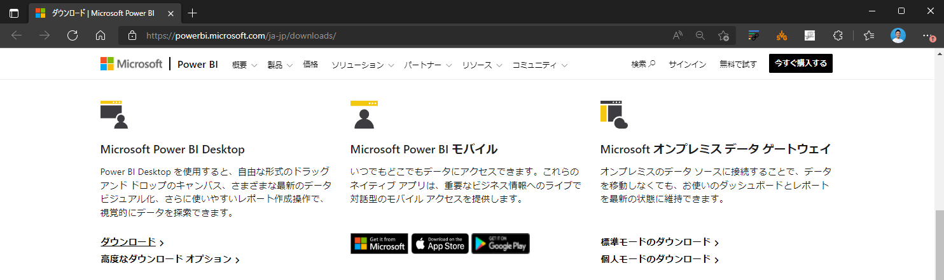

Slide 5
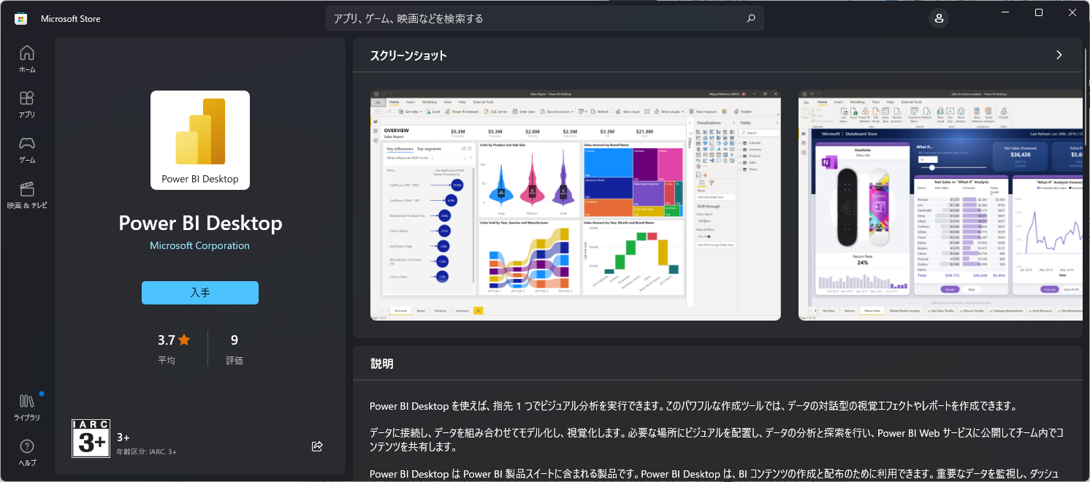

Slide 6
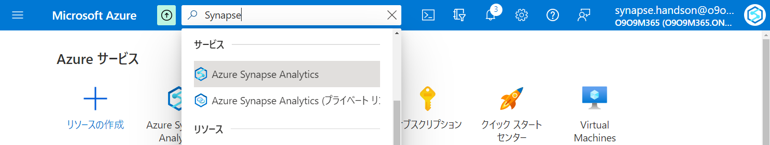

Slide 7
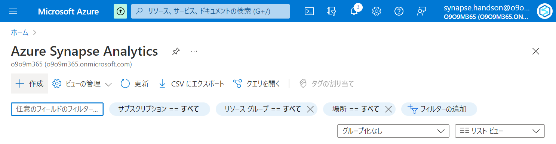

Slide 8
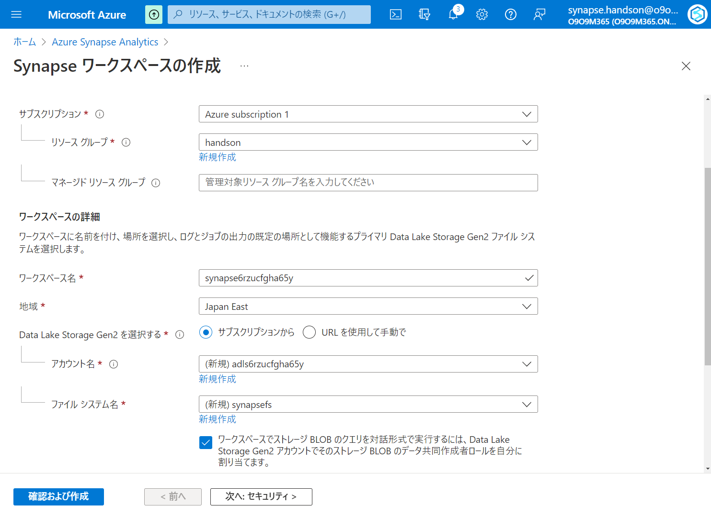

Slide 9
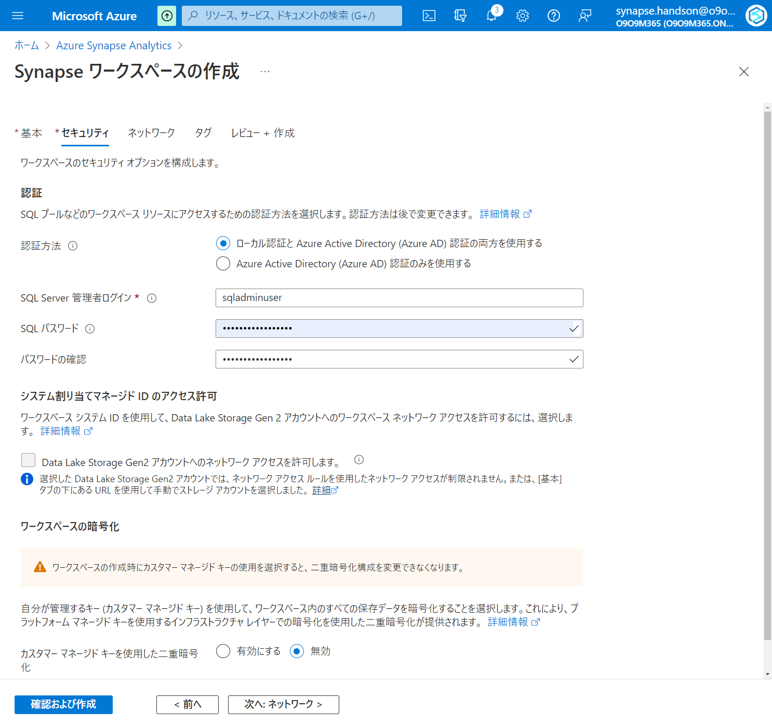

Slide 10
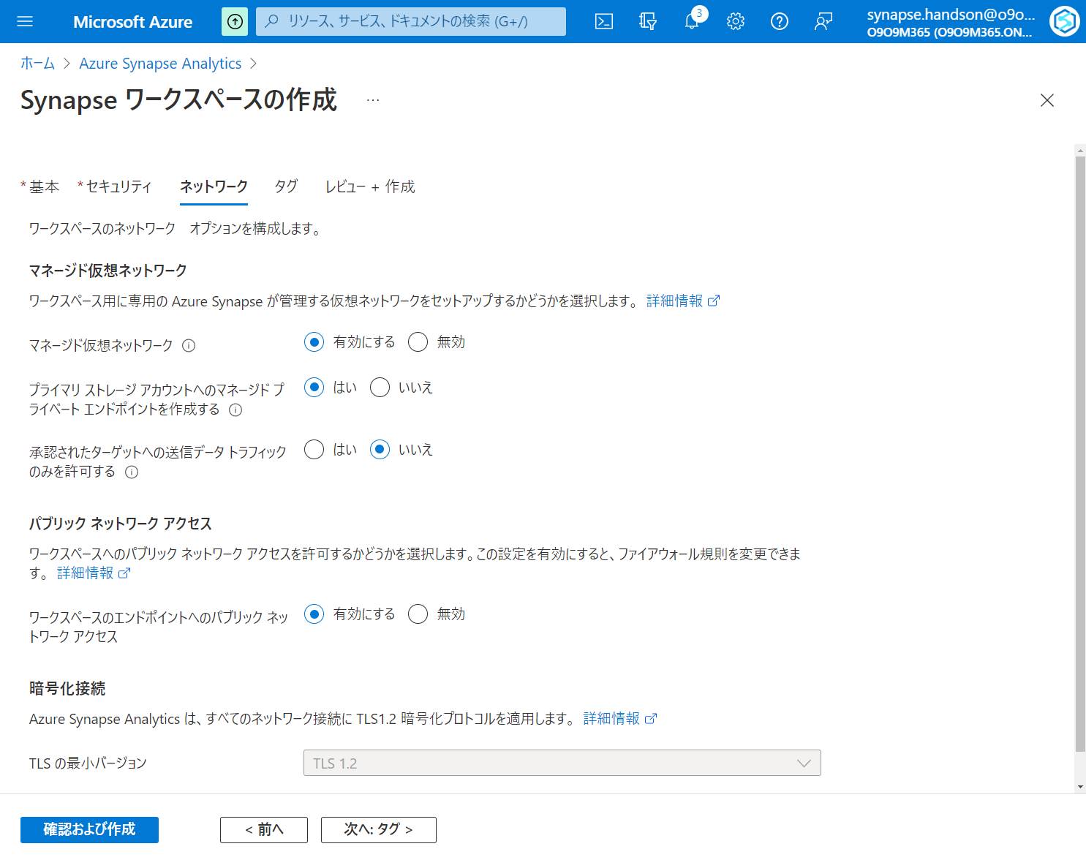

Slide 11
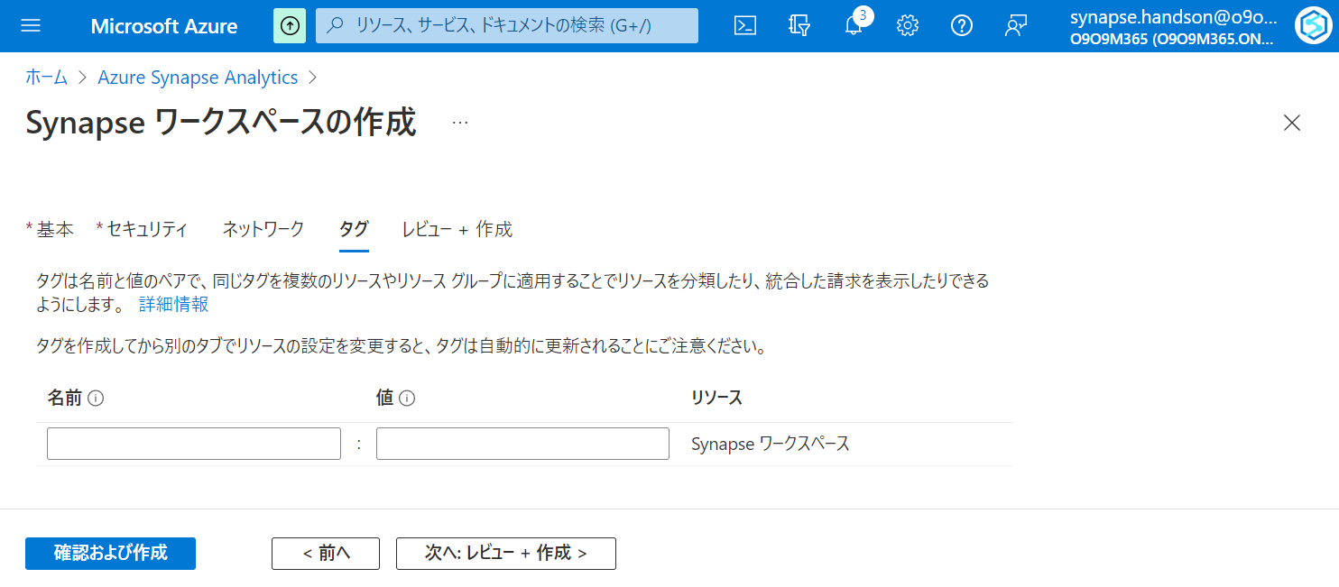

Slide 12
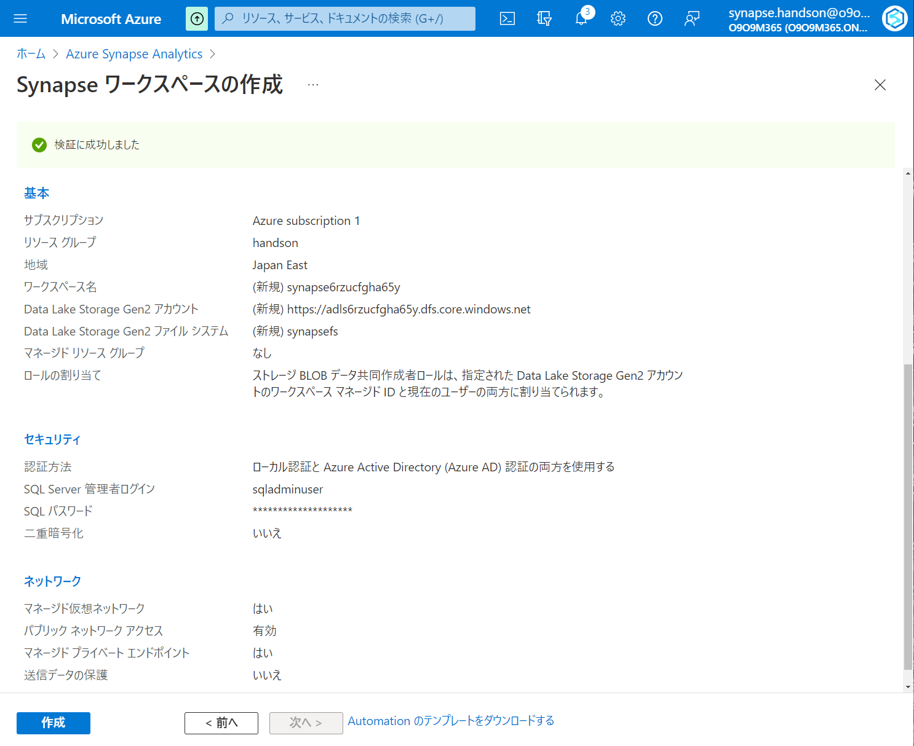

Slide 13
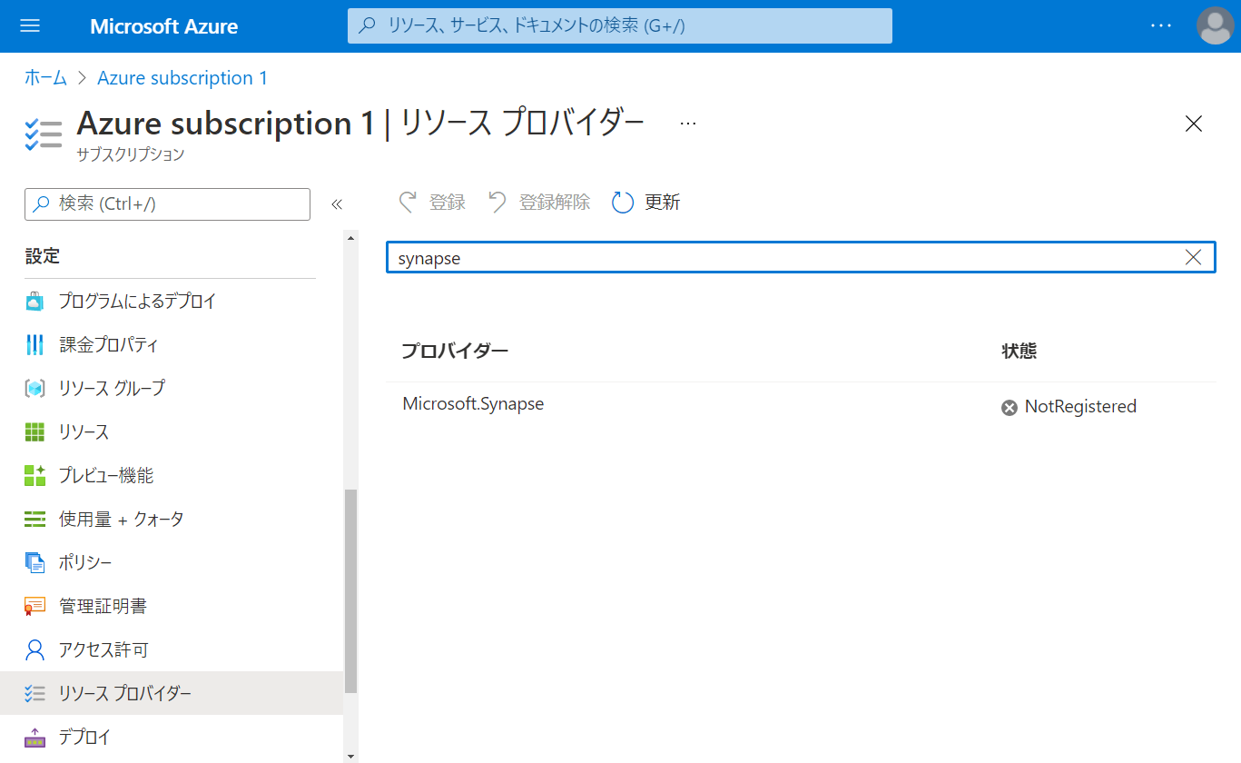

Slide 14
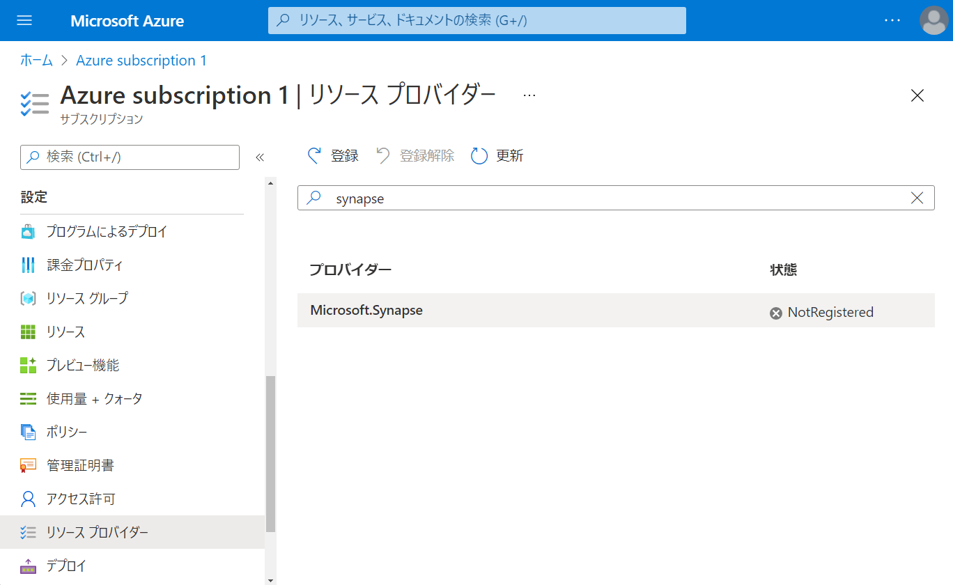

Slide 15
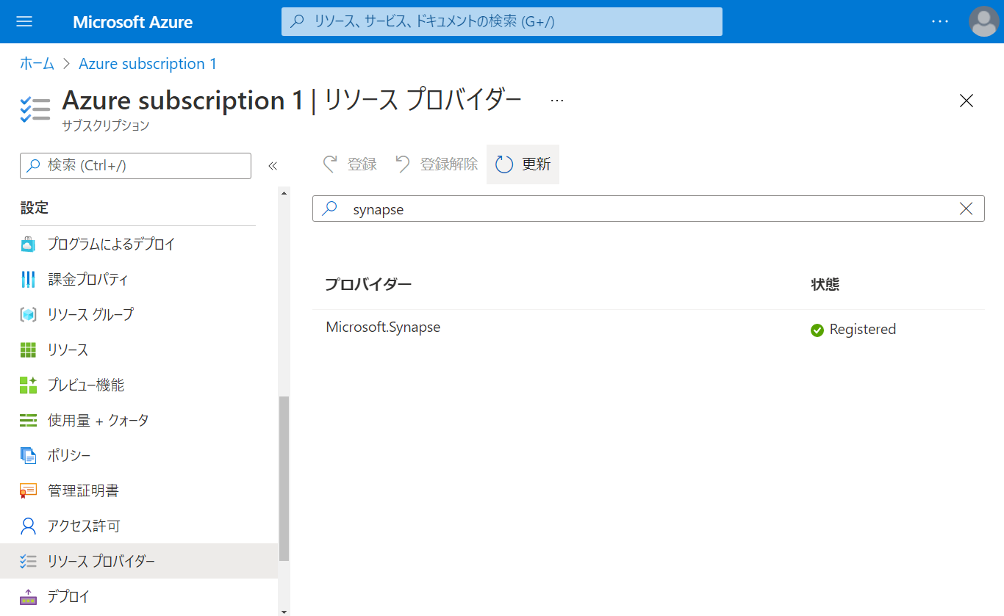

Slide 16
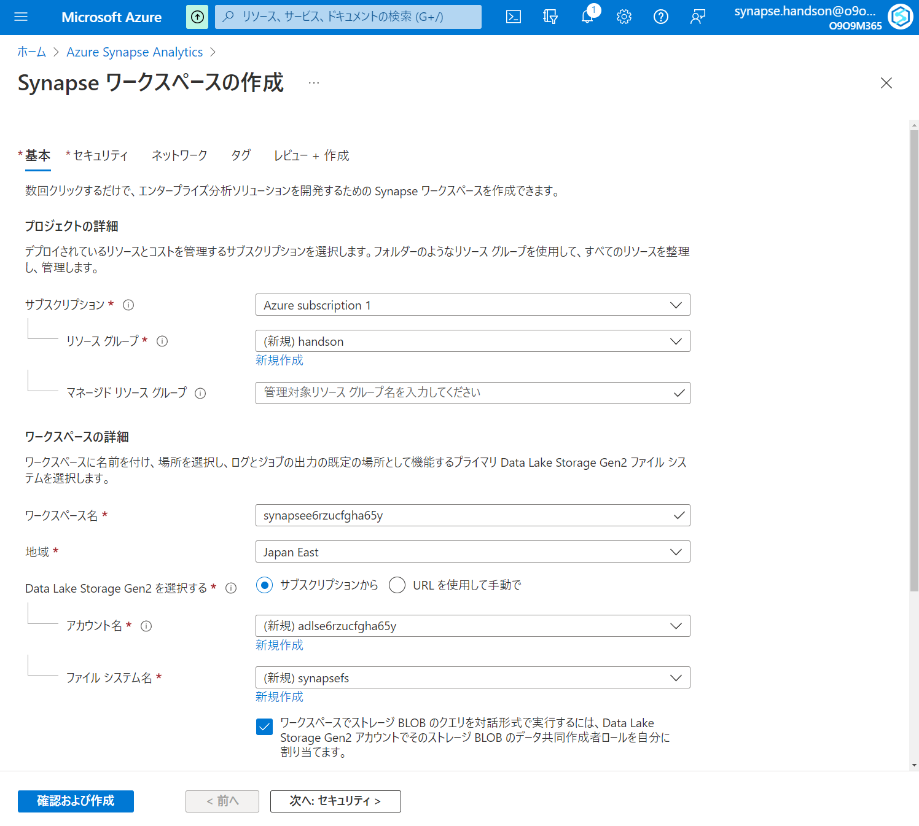

Slide 17
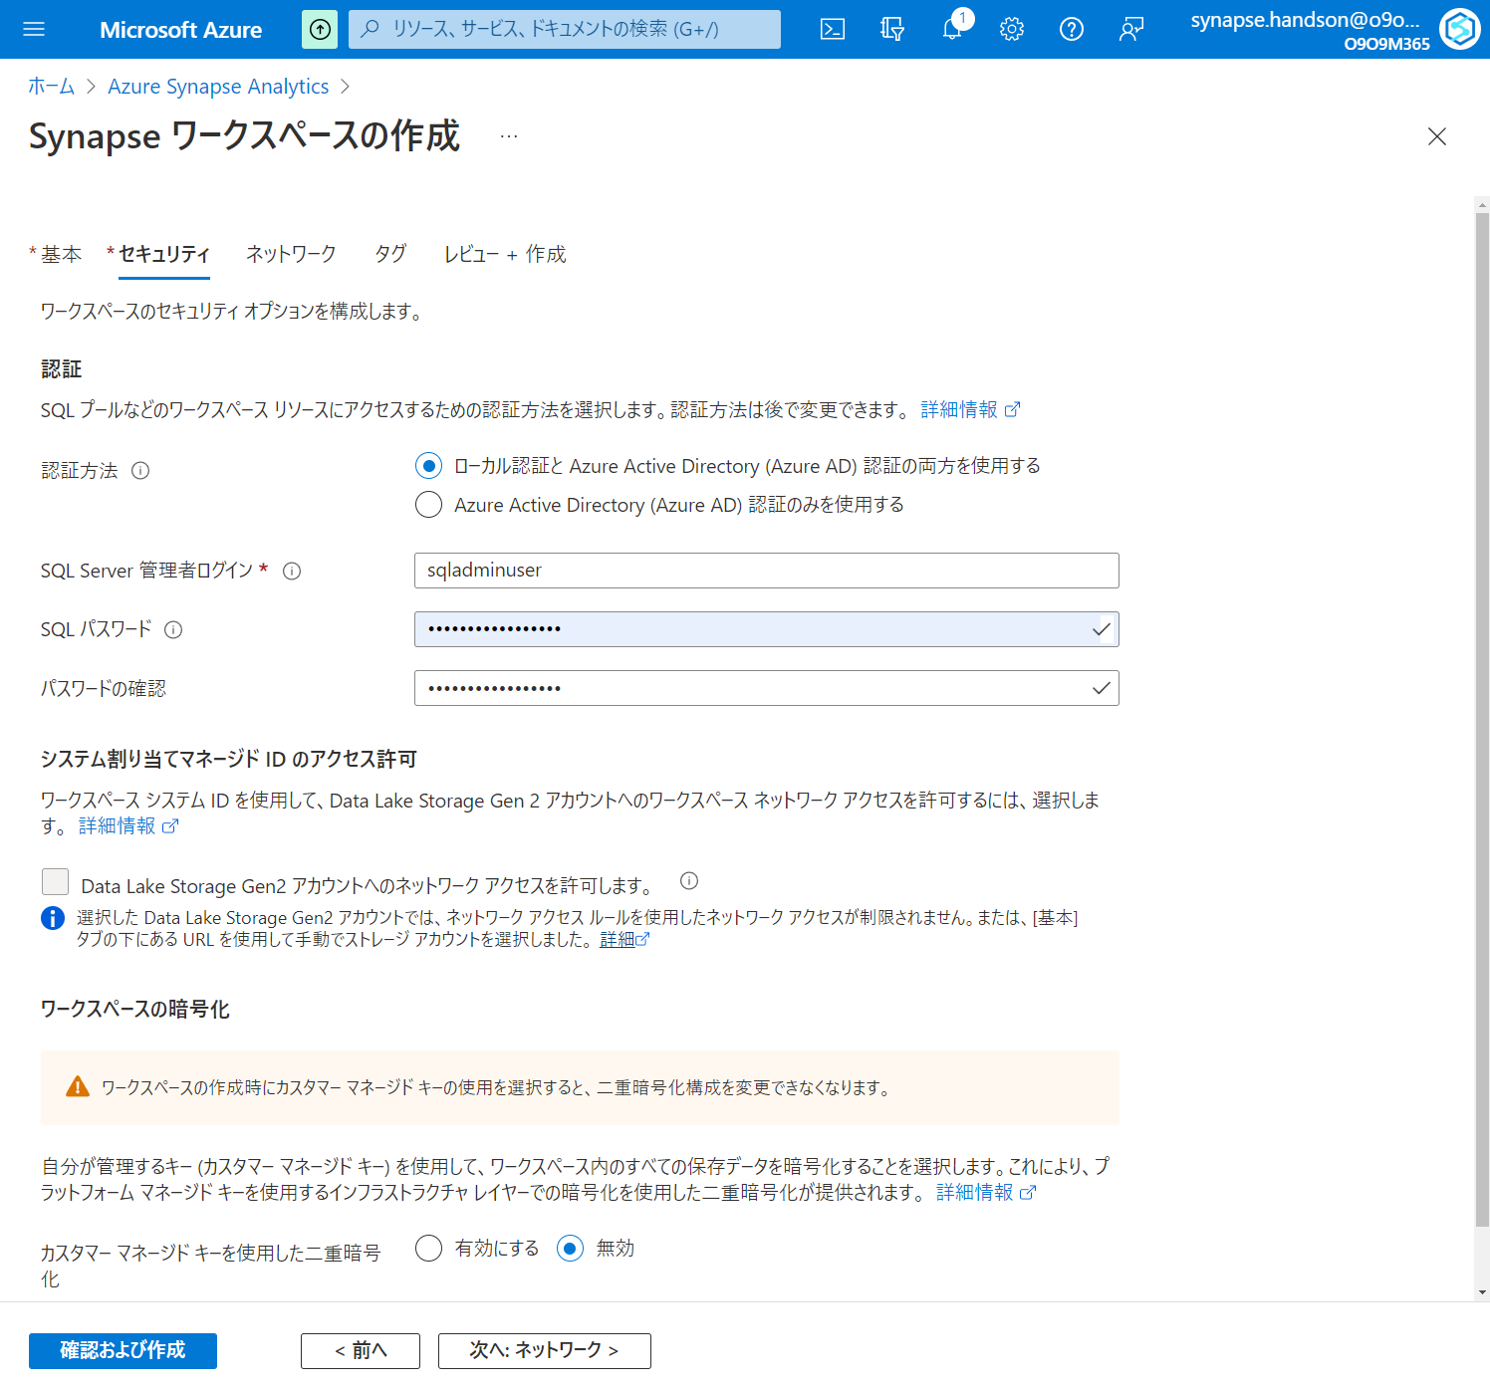

Slide 18
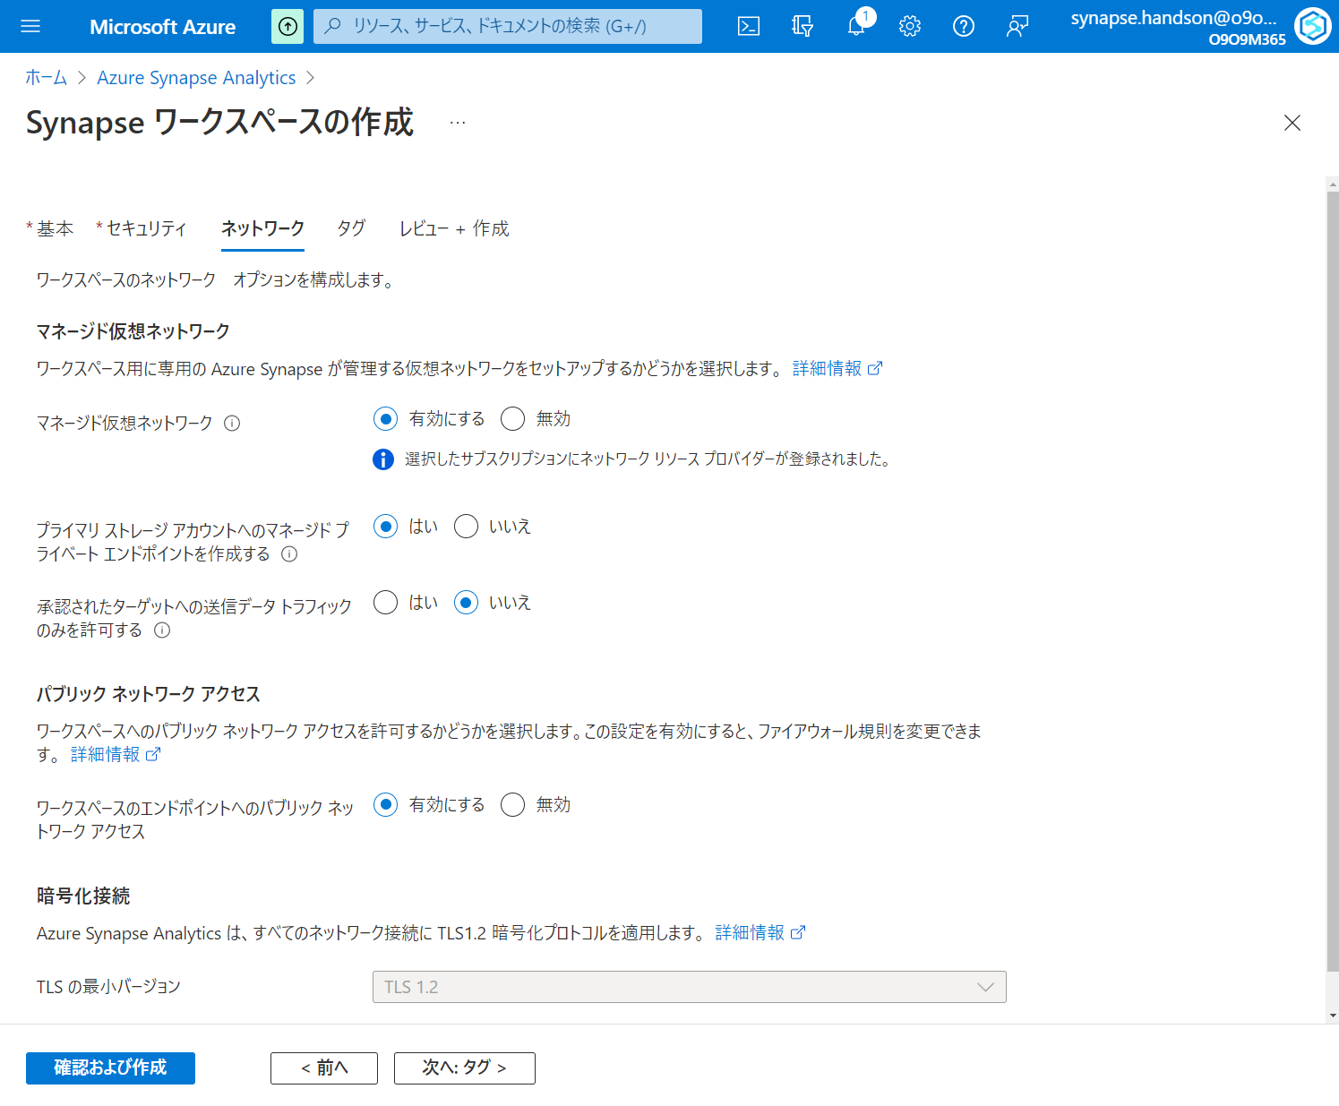

Slide 19
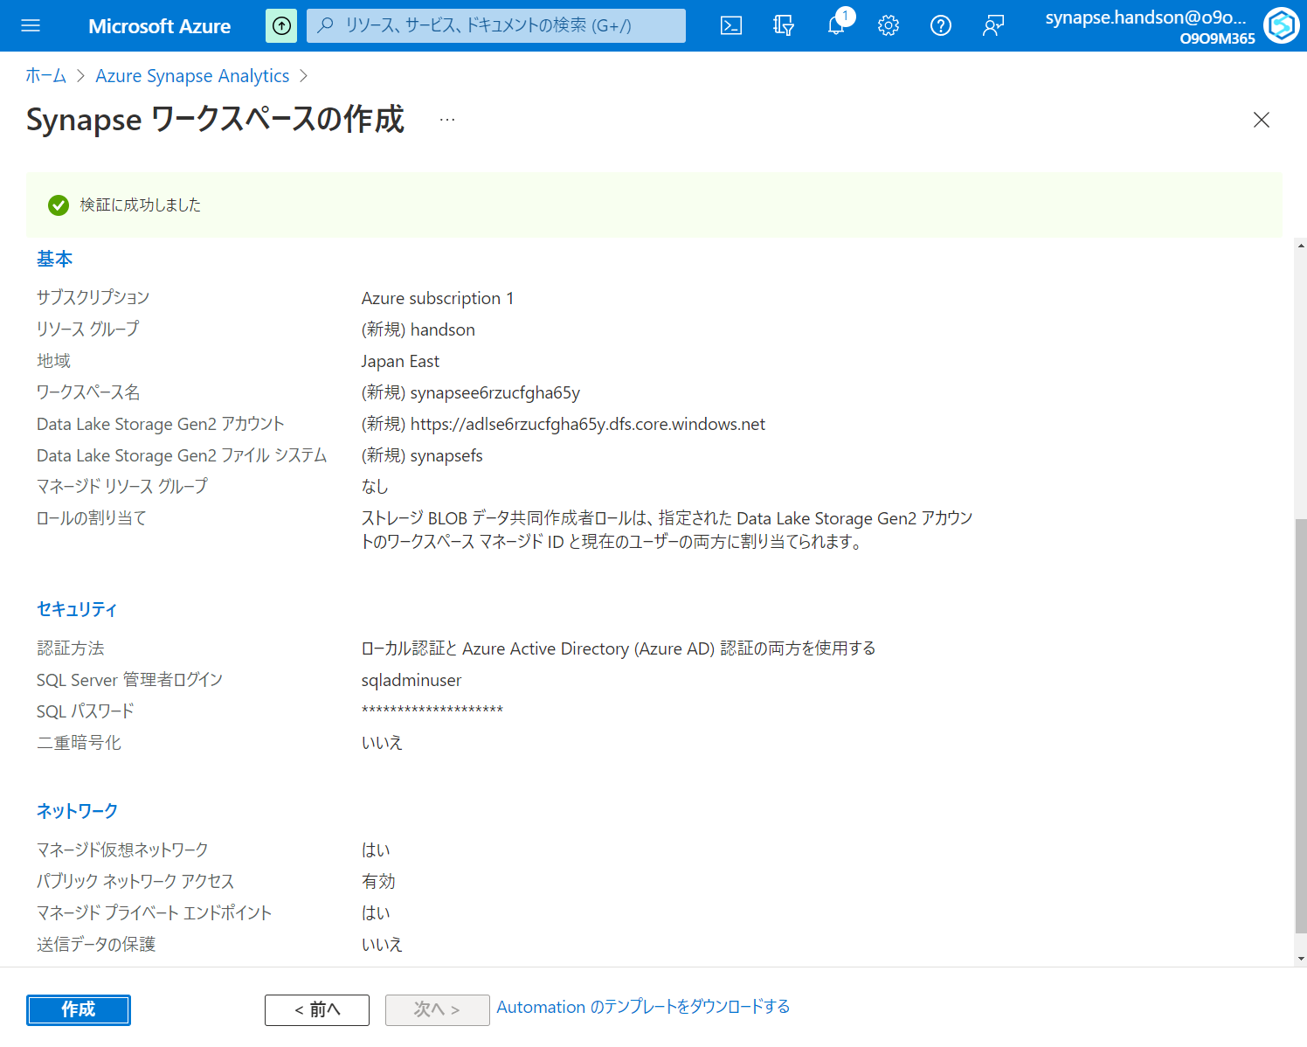

Slide 20
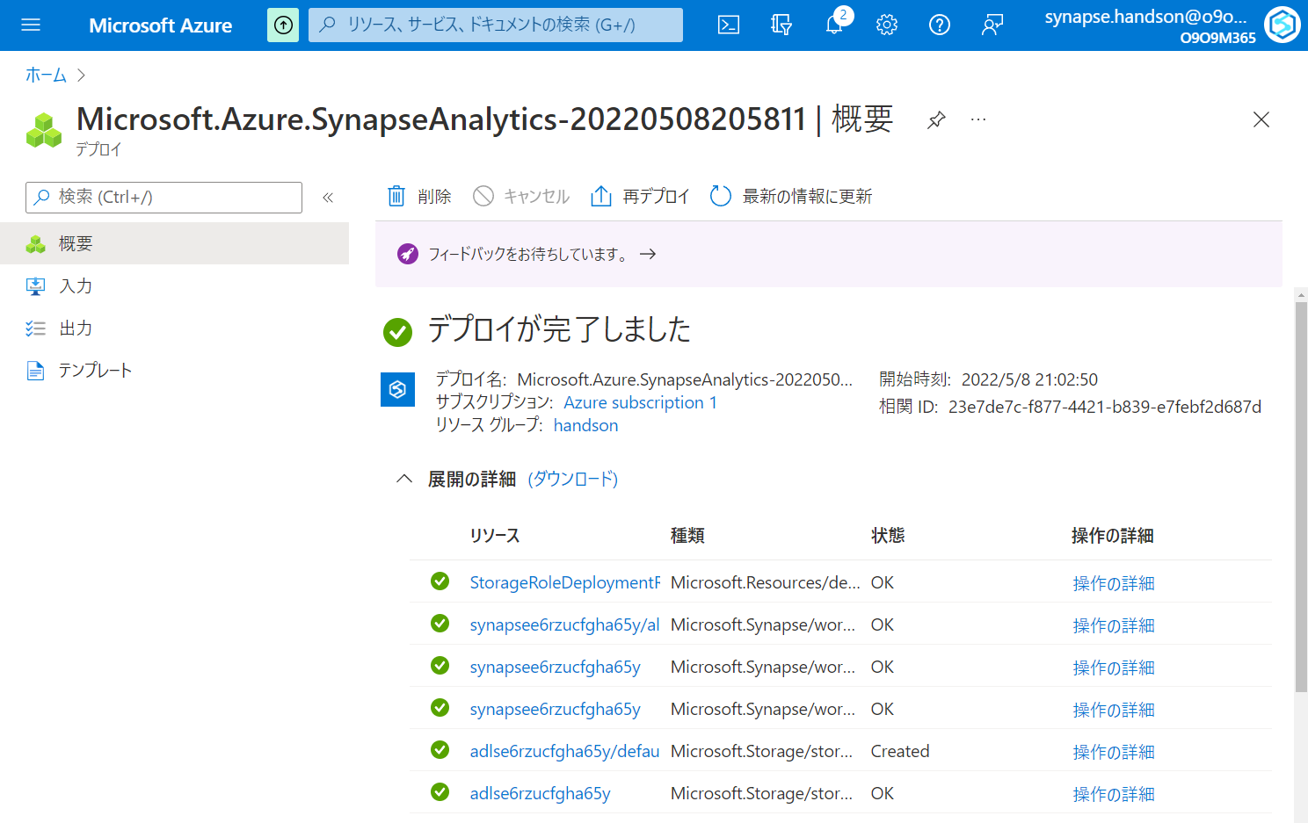

Slide 21
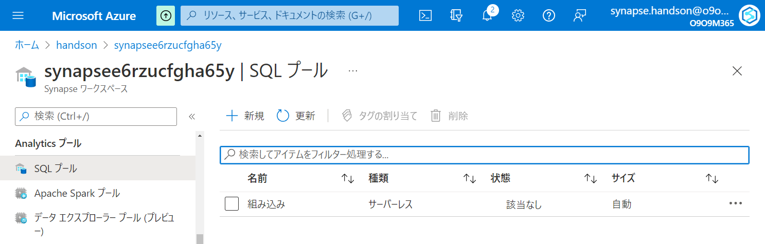

Slide 22
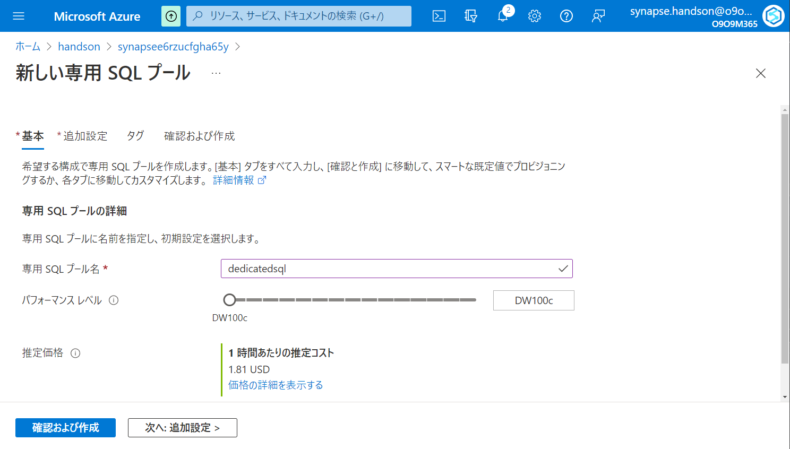

Slide 23
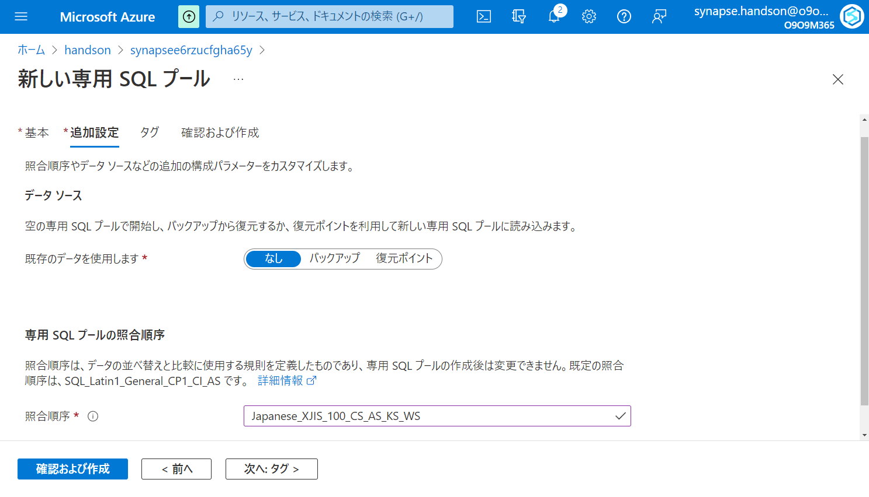

Slide 24
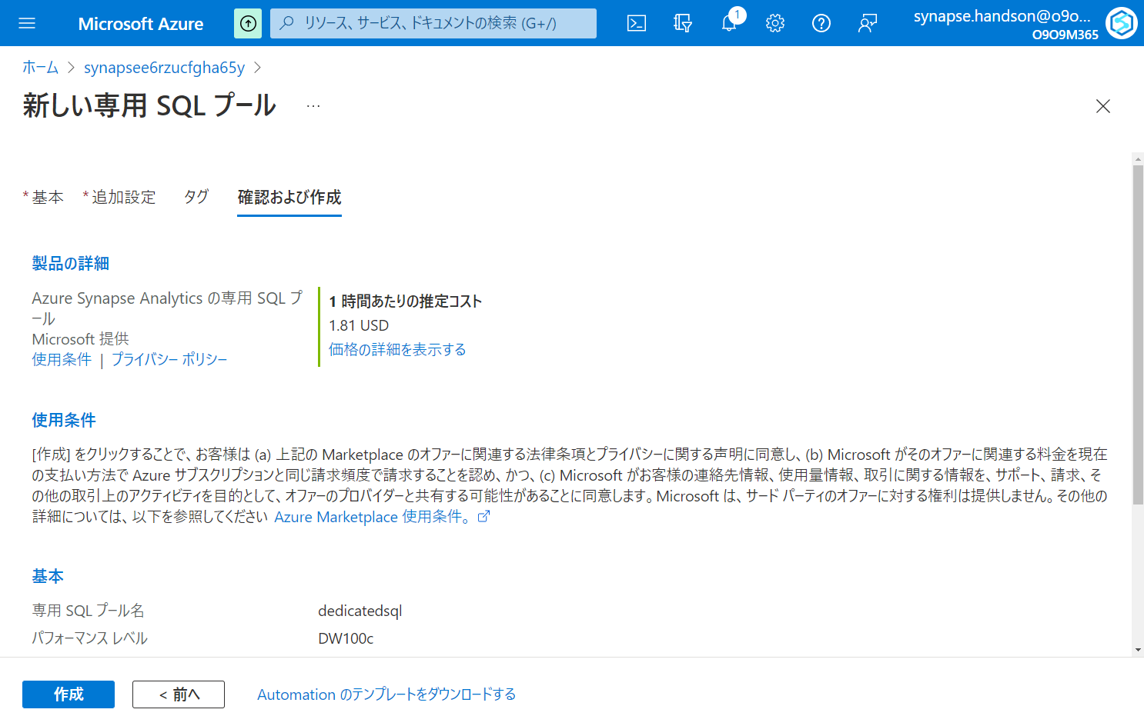

Slide 25
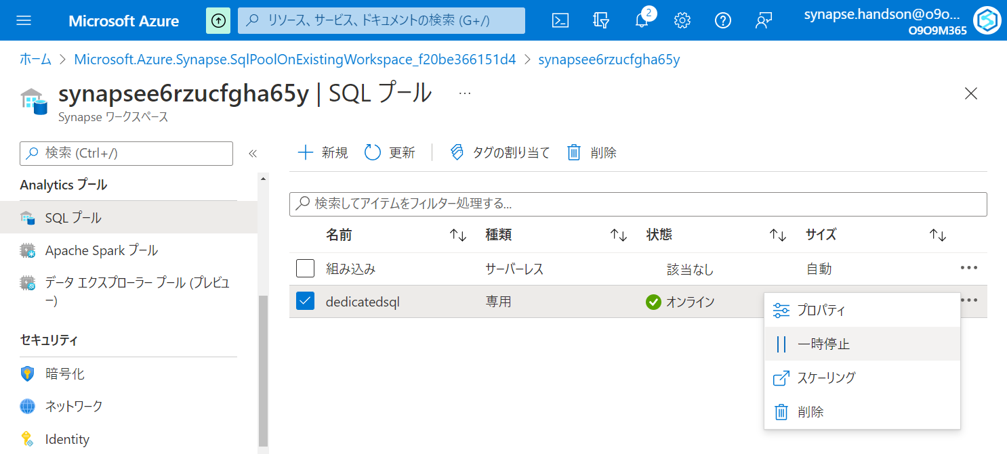

Slide 26
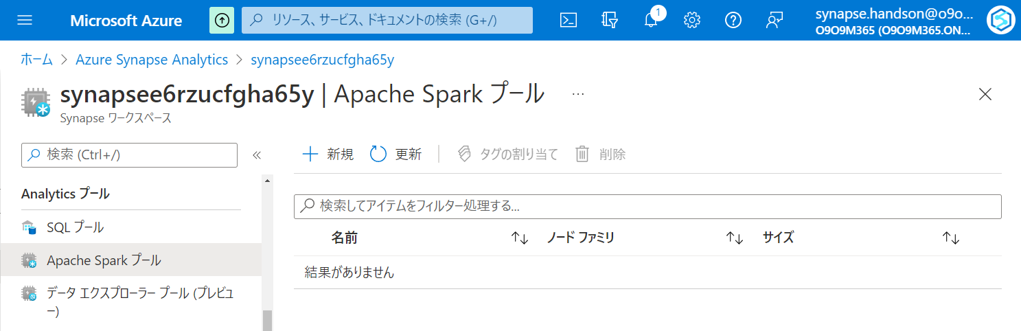

Slide 27
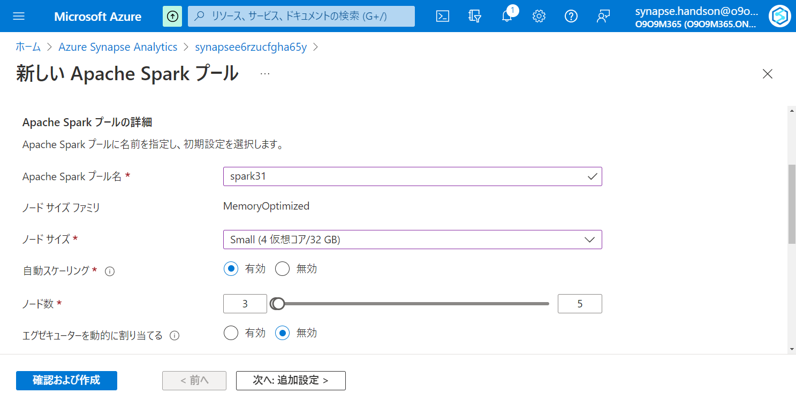

Slide 28
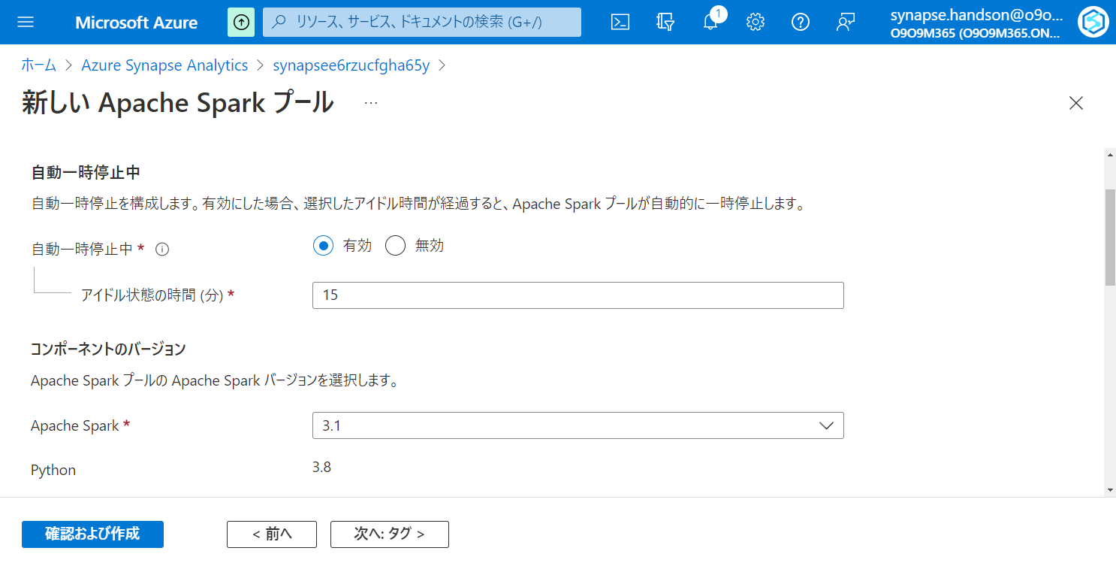

Slide 29
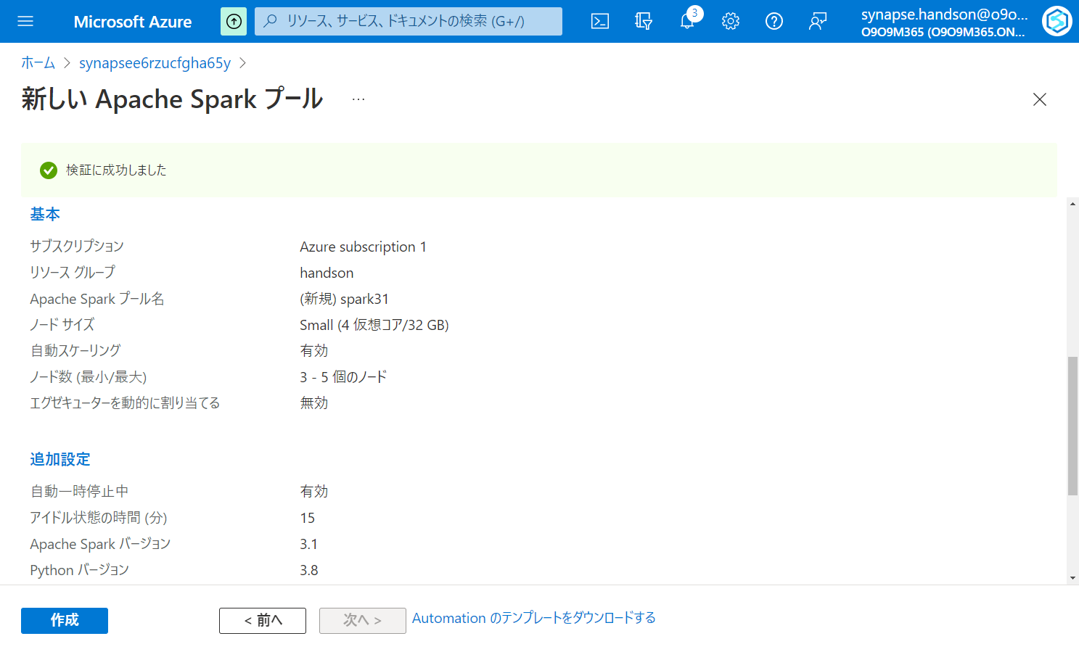

Slide 30
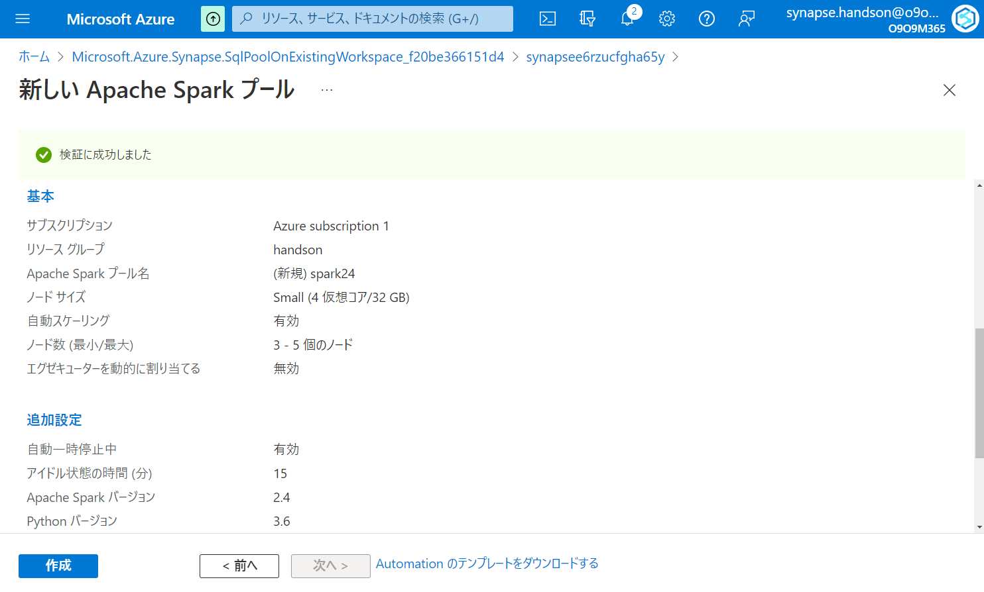

Slide 31
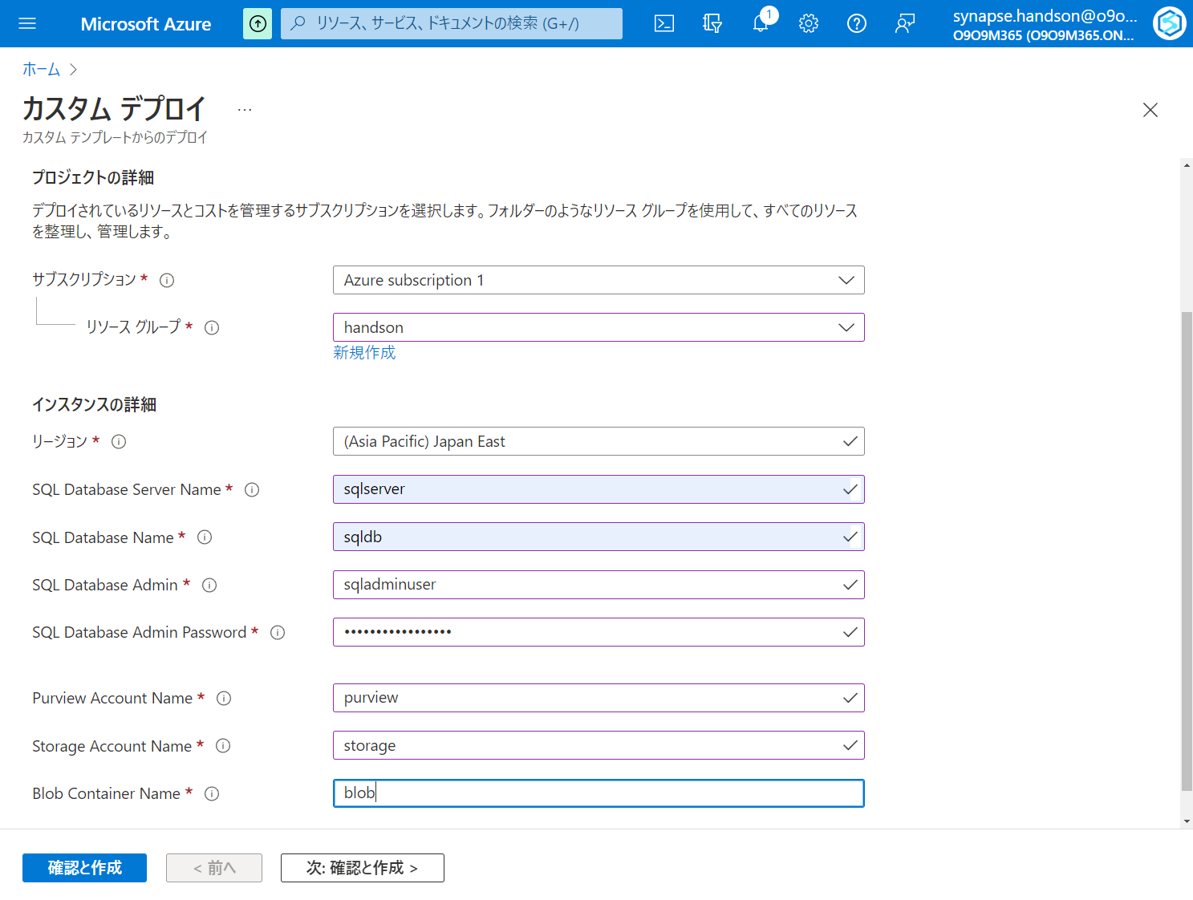

Slide 32
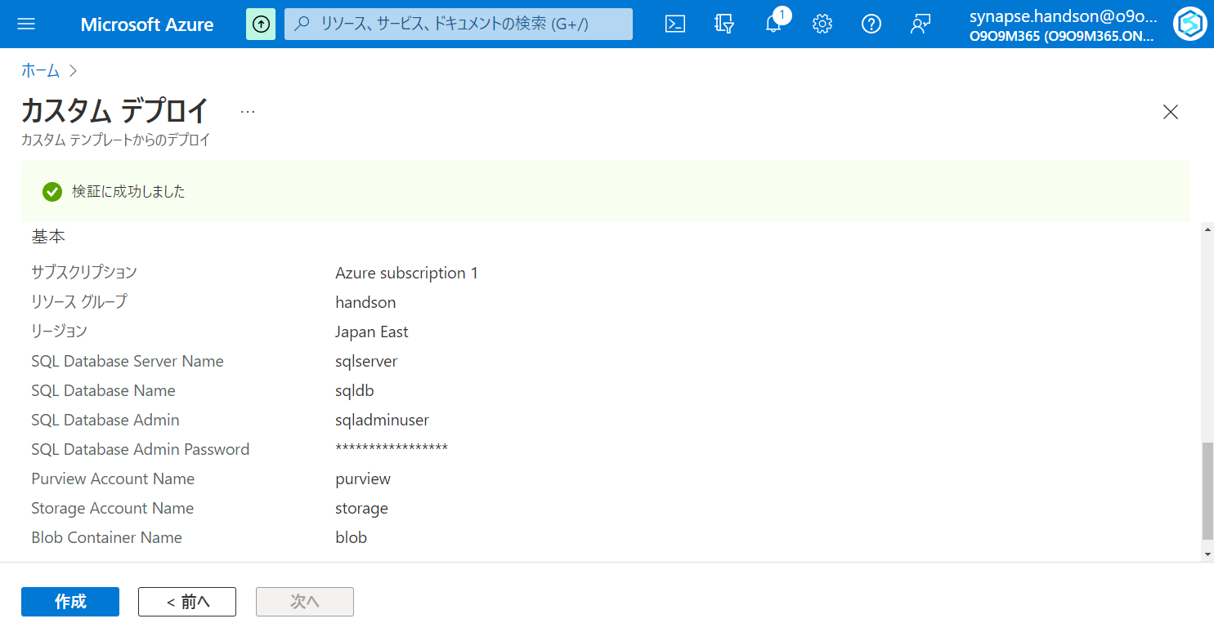

Slide 33
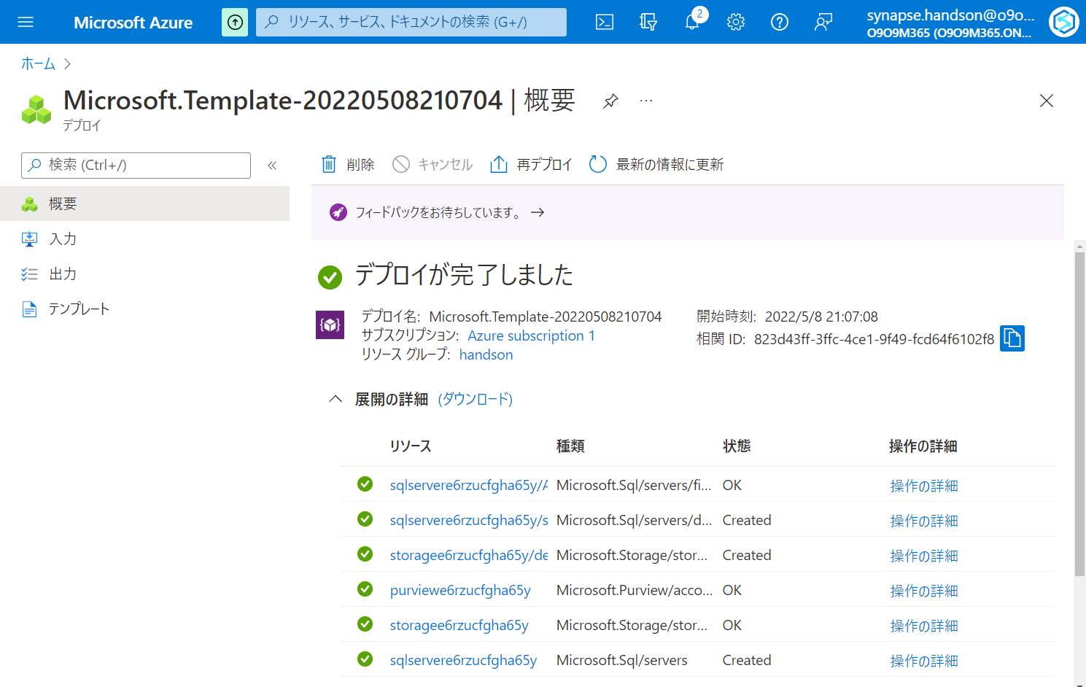

Slide 34
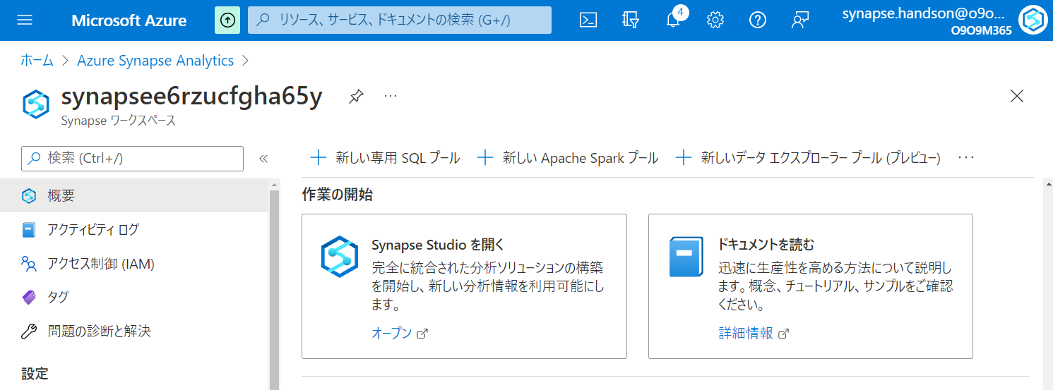

Slide 35
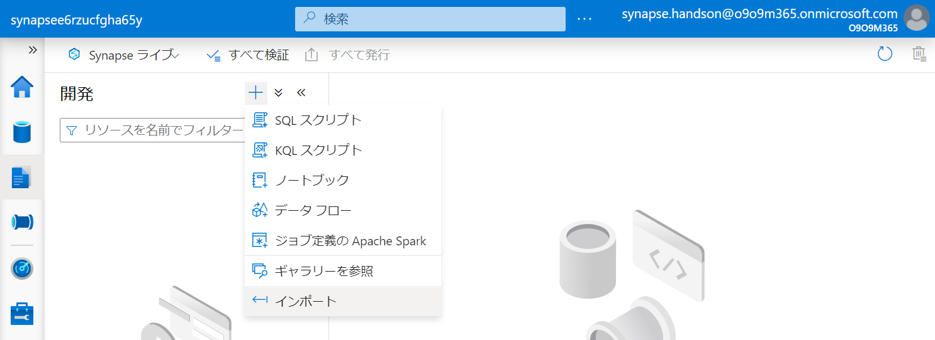

Slide 36
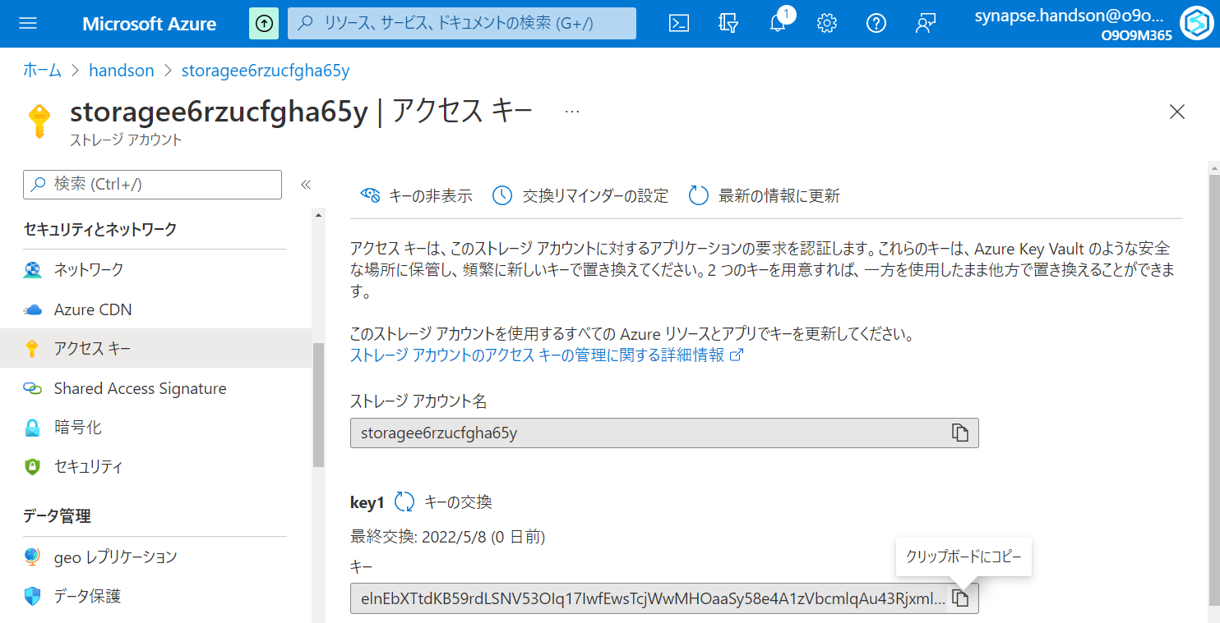

Slide 37
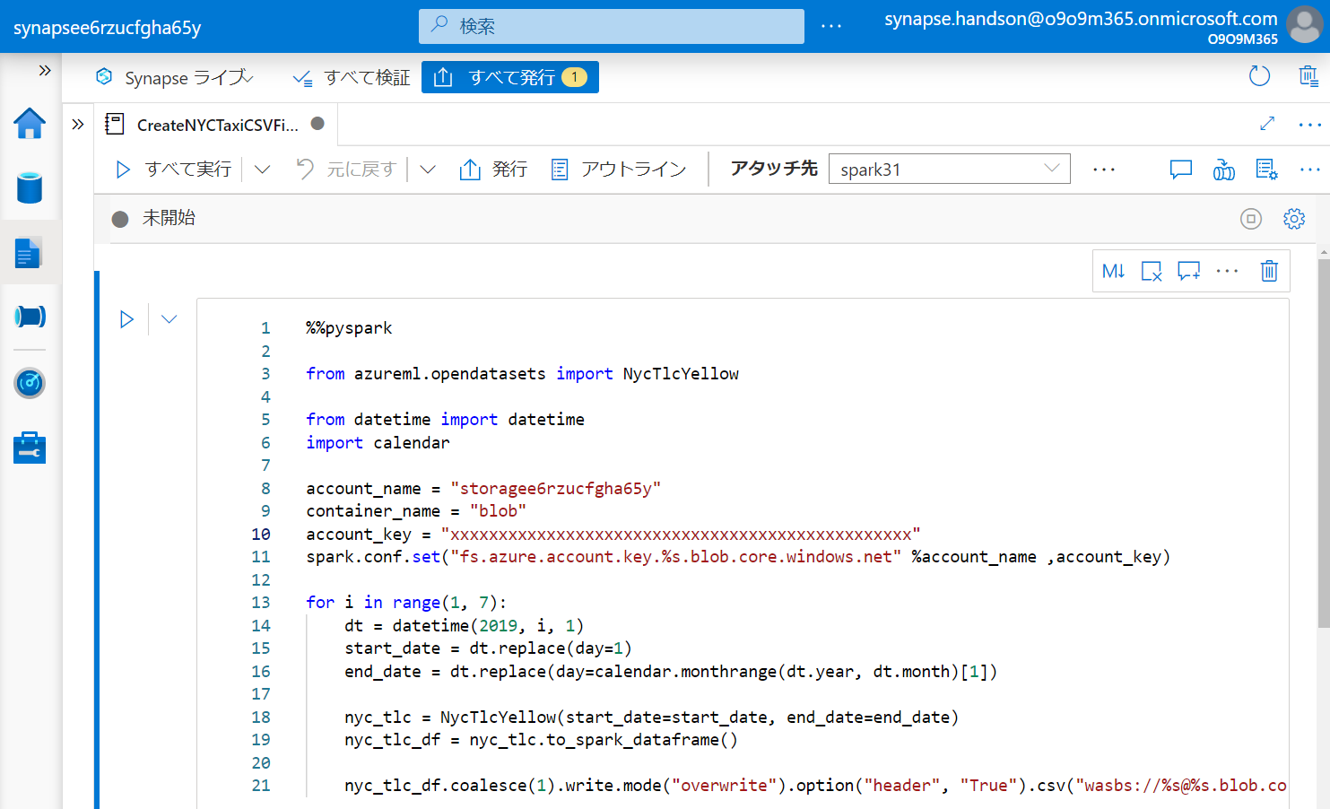

Slide 38
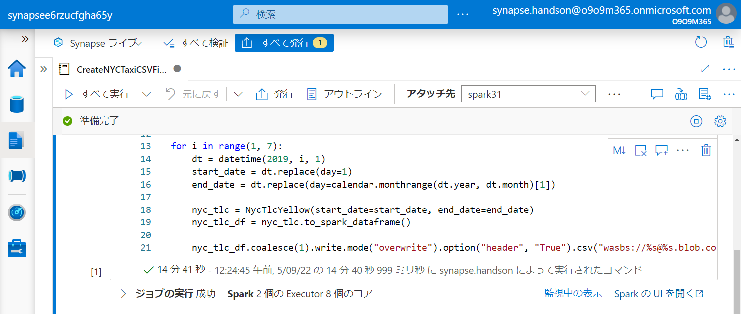

Slide 39
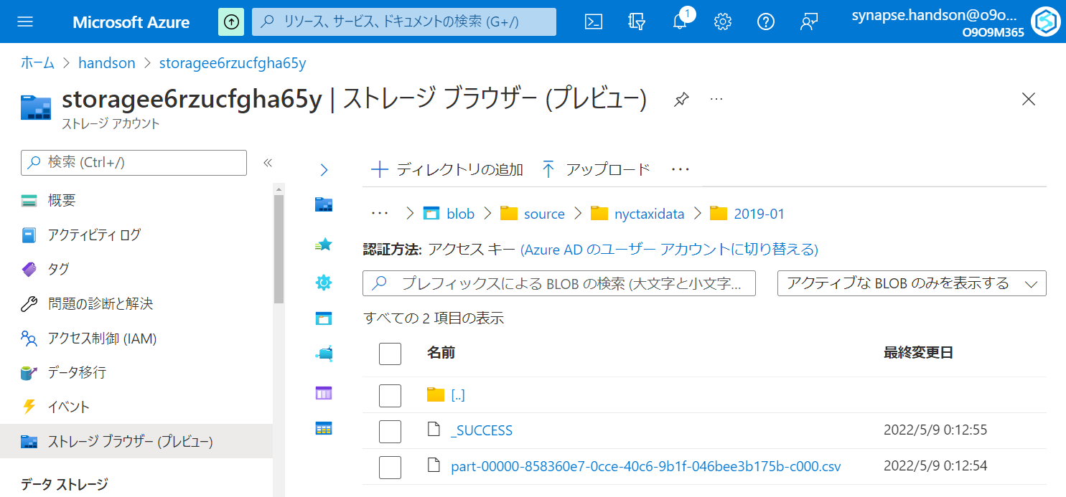

Slide 40
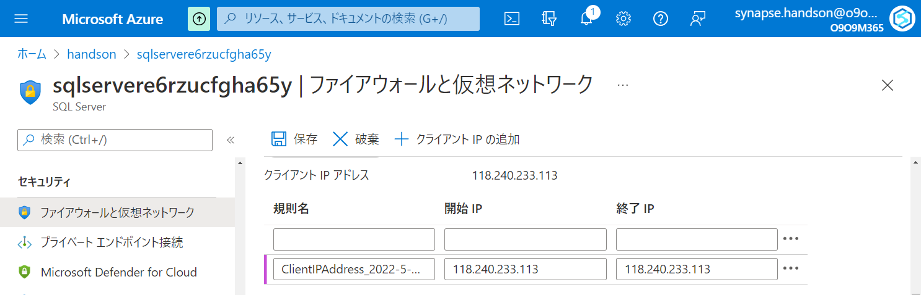

Slide 41
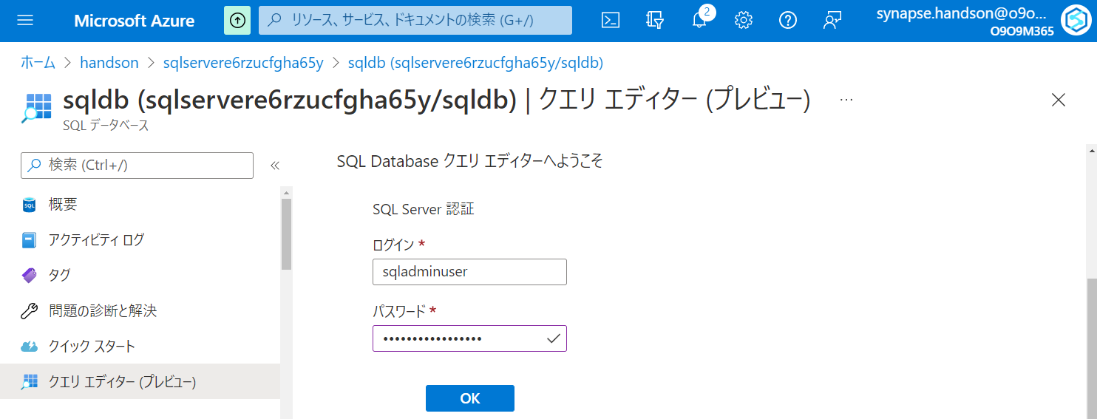

Slide 42
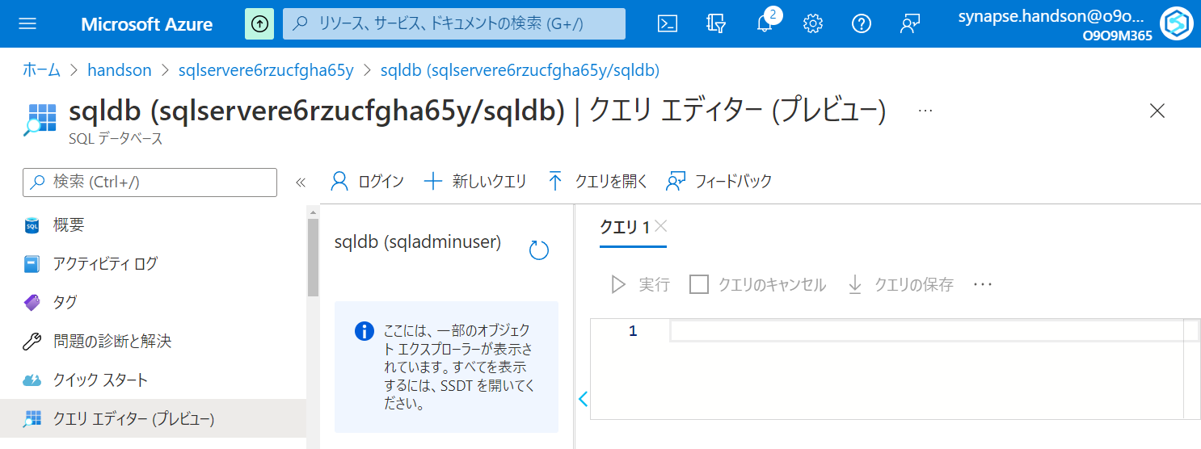

Slide 43
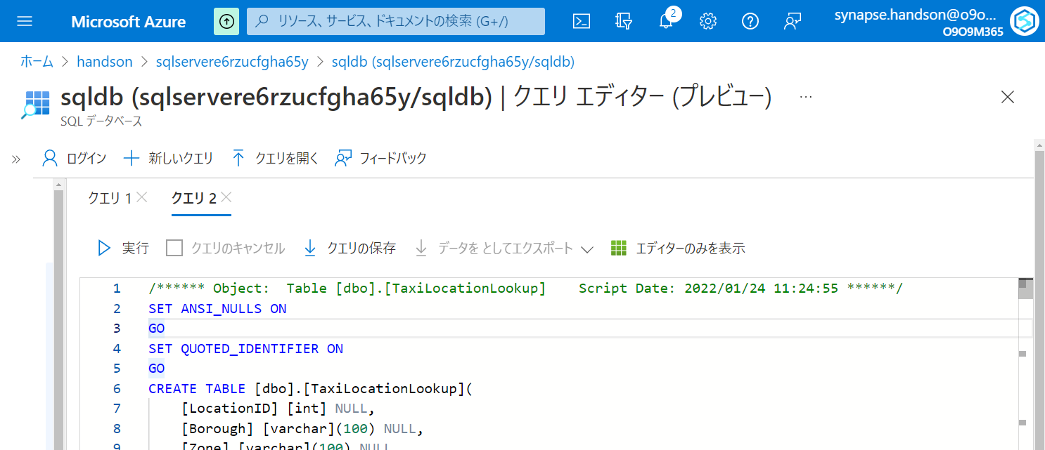

Slide 44
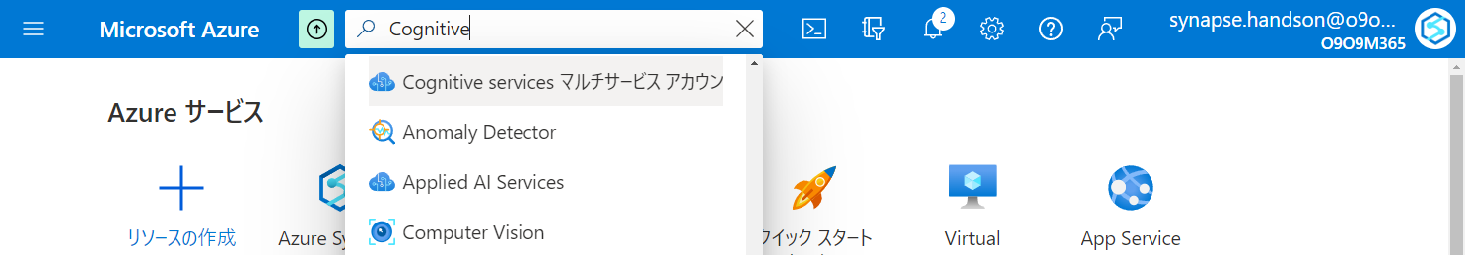

Slide 45
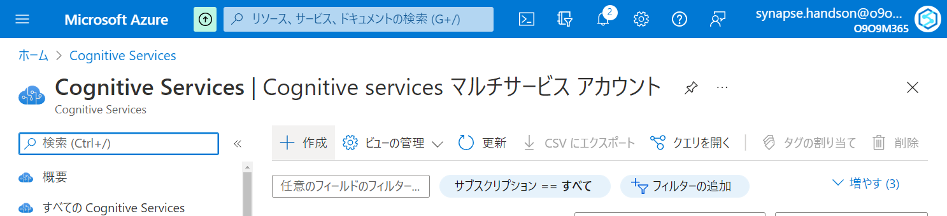

Slide 46
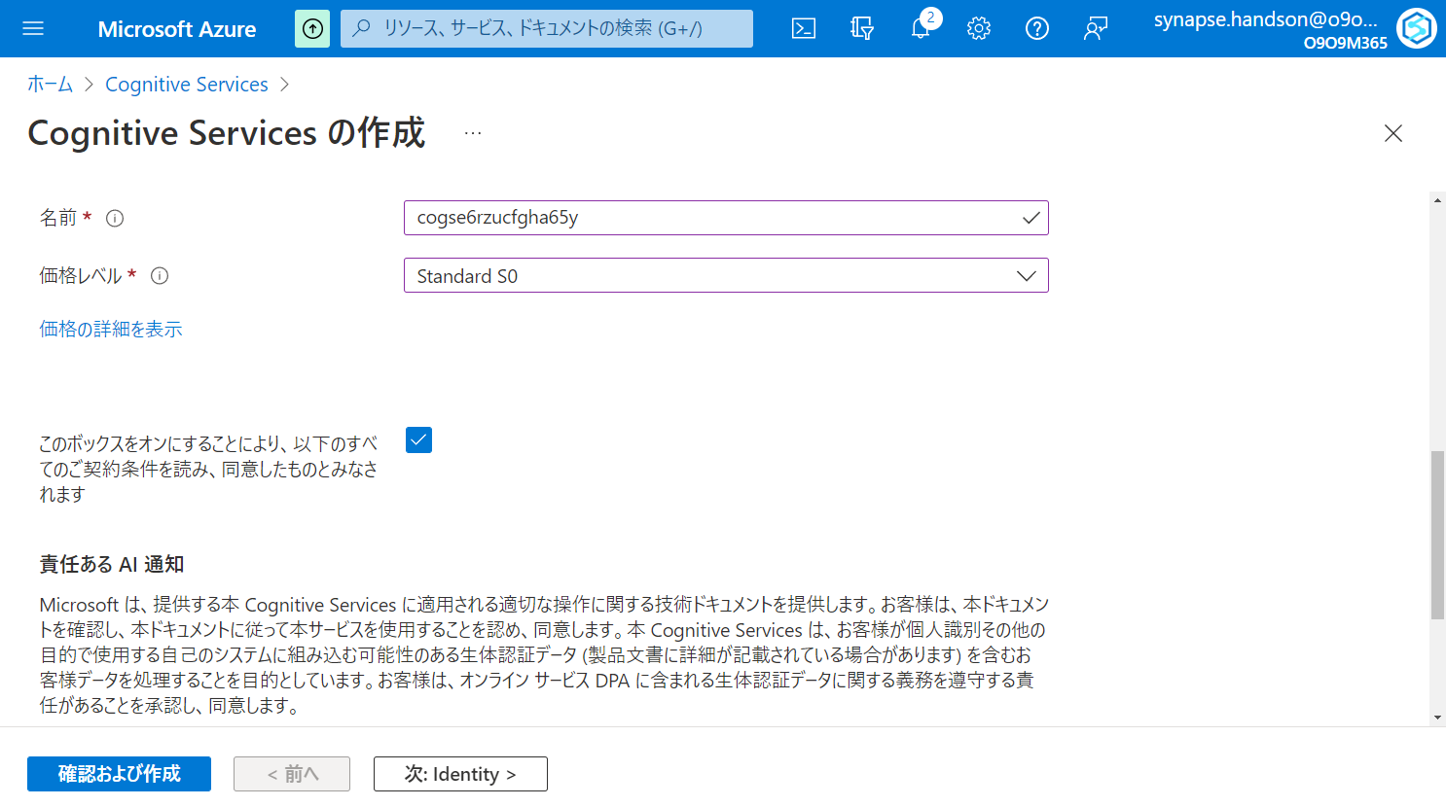

Slide 47
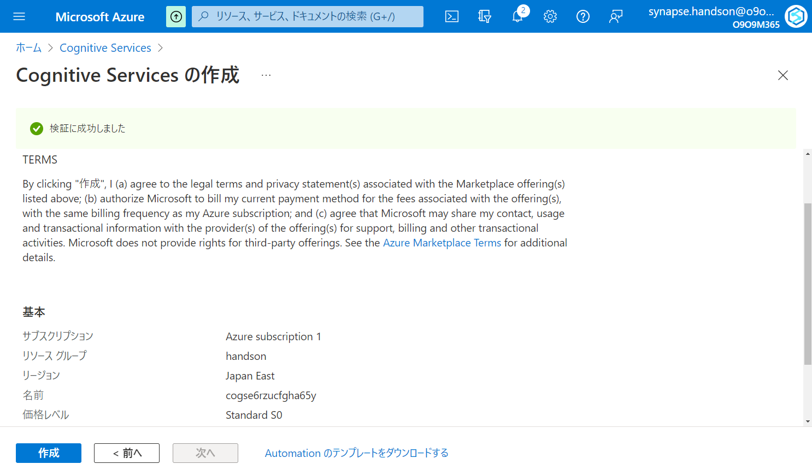

Slide 48
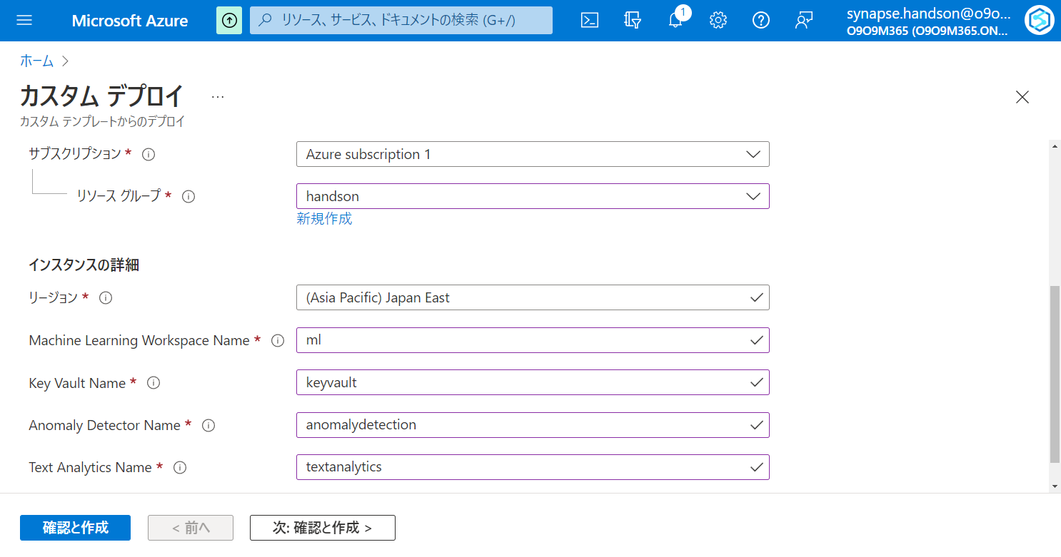

Slide 49
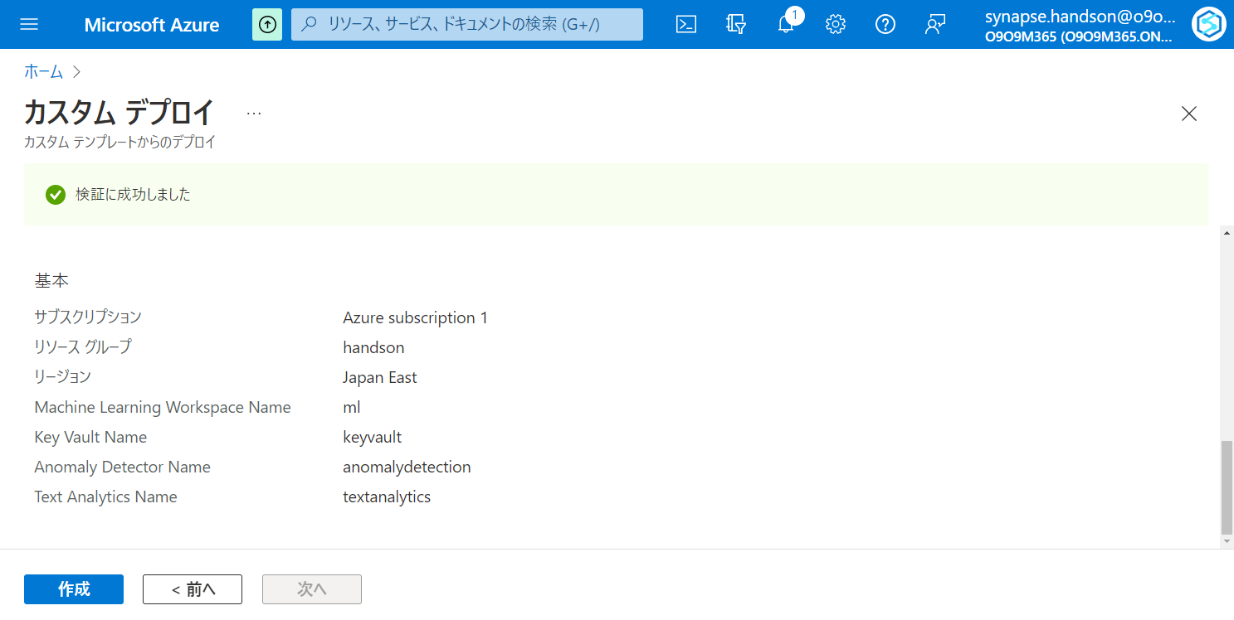

Slide 50
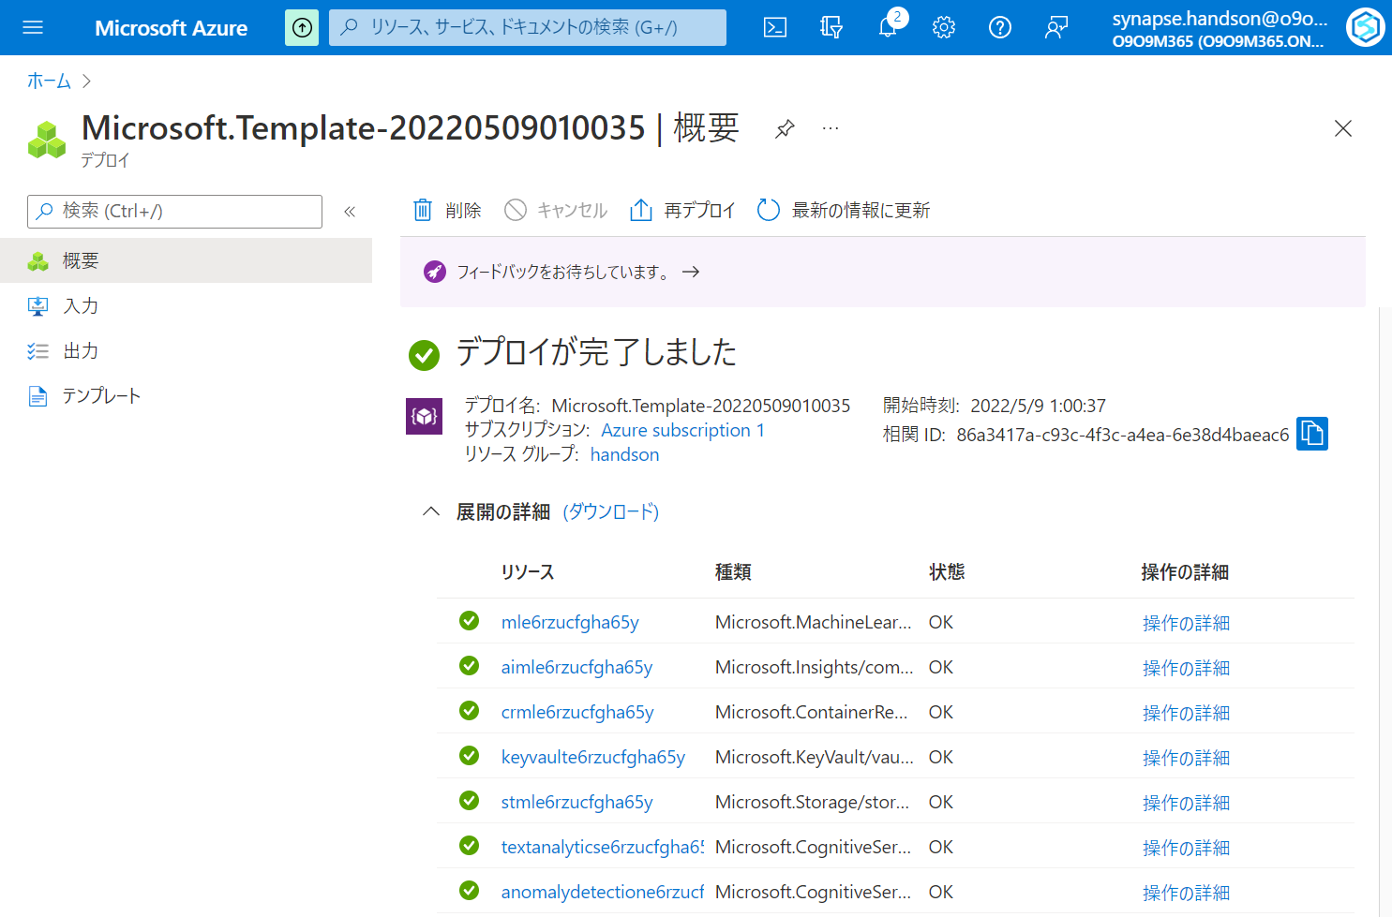

Slide 51
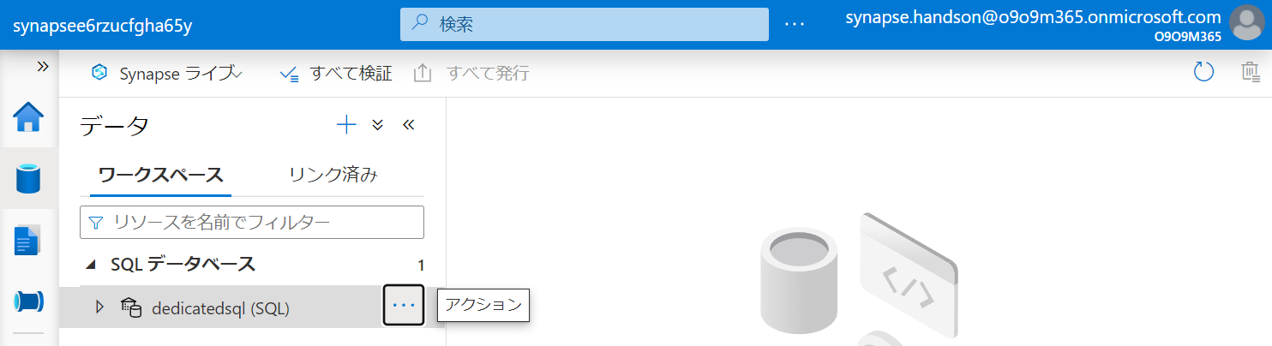

Slide 52
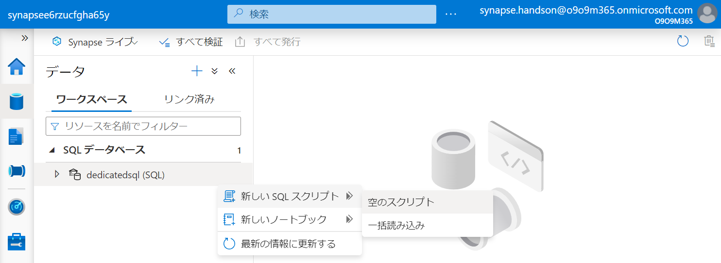

Slide 53
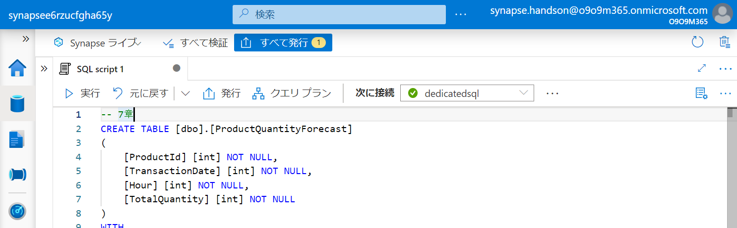

Slide 54


Slide 55


Slide 56


Slide 57


Slide 58


Slide 59


Slide 60


Slide 61


Slide 62


Slide 63


Slide 64


Slide 65


Slide 66


Slide 67


Slide 68


Slide 69


Slide 70


Slide 71


Slide 72


Slide 73
第5章：データの統合と可視化
Generate
Ingest
Store
Process
Enrich
Serve
Consume
On-Prems / Cloud
Realtime
Stream
Hot Path
IoT Hub
Batch
Functions
Power BI Premium
Dashboard
Event Hubs
Stream Analytics
Un/Semi -Structured
Cognitive Services
Analytics
SQL Database
Relational
Dedicated SQL
Data Explorer
Machine Learning
Cold Path
Dataflow
Cosmos DB
Data-driven Applications
Pipeline
NoSQL
Serverless Spark
Serverless SQL
HTAP with Synapse Link
Data Lake
Data Share
Shared Datasets
Discover & Govern
Azure Purview
Azure Active Directory
Azure Cost Management
Azure Key Vault
Azure Security Center
Platform
Azure Monitor
Azure DevOps
GitHub
Azure Policy

Slide 75


Slide 76


Slide 77


Slide 78


Slide 79


Slide 80


Slide 82


Slide 83


Slide 84


Slide 85


Slide 86


Slide 87


Slide 88


Slide 89


Slide 90


Slide 91


Slide 92


Slide 95


Slide 97


Slide 98


Slide 99


Slide 101


Slide 102


Slide 103


Slide 104


Slide 105


Slide 106


Slide 107


Slide 108


Slide 109


Slide 110


Slide 111


Slide 112

ドラッグ & ドロップ

Slide 113


Slide 114


Slide 115

ドラッグ & ドロップ

Slide 116


Slide 117


Slide 118


Slide 119


Slide 120


Slide 121


Slide 122


Slide 123


Slide 129
第6章：アドホックデータ探索とデータプレパレーション
Generate
Ingest
Store
Process
Enrich
Serve
Consume
On-Prems / Cloud
Realtime
Stream
Hot Path
IoT Hub
Batch
Functions
Power BI Premium
Dashboard
Event Hubs
Stream Analytics
Un/Semi -Structured
Cognitive Services
Analytics
SQL Database
Relational
Dedicated SQL
Data Explorer
Machine Learning
Cold Path
Dataflow
Cosmos DB
Data-driven Applications
Pipeline
NoSQL
Serverless Spark
Serverless SQL
HTAP with Synapse Link
Data Lake
Data Share
Shared Datasets
Discover & Govern
Azure Purview
Azure Active Directory
Azure Cost Management
Azure Key Vault
Azure Security Center
Platform
Azure Monitor
Azure DevOps
GitHub
Azure Policy

Slide 130
第7章：機械学習統合によるデータエンリッチメント
Generate
Ingest
Store
Process
Enrich
Serve
Consume
On-Prems / Cloud
Realtime
Stream
Hot Path
IoT Hub
Batch
Functions
Power BI Premium
Dashboard
Event Hubs
Stream Analytics
Un/Semi -Structured
Cognitive Services
Analytics
SQL Database
Relational
Dedicated SQL
Data Explorer
Machine Learning
Cold Path
Dataflow
Cosmos DB
Data-driven Applications
Pipeline
NoSQL
Serverless Spark
Serverless SQL
HTAP with Synapse Link
Data Lake
Data Share
Shared Datasets
Discover & Govern
Azure Purview
Azure Active Directory
Azure Cost Management
Azure Key Vault
Azure Security Center
Platform
Azure Monitor
Azure DevOps
GitHub
Azure Policy

Slide 131


Slide 132


Slide 133
第8章：リアルタイムデータ分析
Generate
Ingest
Store
Process
Enrich
Serve
Consume
On-Prems / Cloud
Realtime
Stream
Hot Path
IoT Hub
Batch
Functions
Power BI Premium
Dashboard
Event Hubs
Stream Analytics
Un/Semi -Structured
Cognitive Services
Analytics
SQL Database
Relational
Dedicated SQL
Data Explorer
Machine Learning
Cold Path
Dataflow
Cosmos DB
Data-driven Applications
Pipeline
NoSQL
Serverless Spark
Serverless SQL
HTAP with Synapse Link
Data Lake
Data Share
Shared Datasets
Discover & Govern
Azure Purview
Azure Active Directory
Azure Cost Management
Azure Key Vault
Azure Security Center
Platform
Azure Monitor
Azure DevOps
GitHub
Azure Policy

Slide 134


Slide 135


Slide 136


Slide 137


Slide 138


Slide 139


Slide 140


Slide 141


Slide 142


Slide 143


Slide 144


Slide 145

不要

Slide 146

不要

Slide 147

不要

Slide 148

不要

Slide 149


Slide 150


Slide 152


Slide 153



Slide 154


Slide 156


Slide 158


Slide 159


Slide 160


Slide 161


Slide 162


Slide 163


Slide 164


Slide 165


Slide 166


Slide 167


Slide 168


Slide 169


Slide 170


Slide 171


Slide 172


Slide 173


Slide 175


Slide 176


Slide 177


Slide 178


Slide 179


Slide 180


Slide 182


Slide 183


Slide 184


Slide 185


Slide 186


Slide 187

右クリック

Slide 188


Slide 190


Slide 191


Slide 192


Slide 194


Slide 195


Slide 196


Slide 197


Slide 198


Slide 199


Slide 200


Slide 201


Slide 202


Slide 203


Slide 204

ドラッグ&ドロップ

Slide 205

ドラッグ&ドロップ

Slide 206


Slide 207


Slide 208

5-2-2-1

Slide 209

5-2-2-1

Slide 210

5-2-2-2

Slide 211

5-2-2-2

Slide 212

5-2-2-2
右クリック

Slide 213

5-2-2-2

Slide 214

5-3-1-1

Slide 215

5-3-1-1

Slide 216

5-3-1-2

Slide 217

5-3-1-2

Slide 218

5-3-1-2

Slide 219

5-3-1-2

Slide 220

5-3-1-2

Slide 221

5-3-1-2

Slide 222

5-3-1-2

Slide 223

5-3-1-2

Slide 224

5-3-1-2

Slide 225

5-3-1-2

Slide 226

5-3-1-2

Slide 227

5-3-1-2
Column Name | Expression
PickUpDate | toDate(tpep_pickup_datetime,'yyyy-MM-dd')
PickUpLocationID | toInteger(PULocationID)
PassengerCount | toInteger(passenger_count)
DistanceTravelled | toDecimal(trip_distance)
TipAmount | toDecimal(tip_amount)
FareAmount | toDecimal(fare_amount)
TotalAmount | toDecimal(total_amount)

Slide 228

5-3-1-2

Slide 229

5-3-1-2

Slide 230

5-3-1-2
- Join Settings > Output stream name: JoinPickUpLocation - Join Settings > Left stream: TransformColumns - Join Settings > Right stream: TaxiLocationLookup - Join Settings > Join type: Inner - Join Settings > Join conditions > Left: PickUpLocationID - Join Settings > Join conditions > Right: LocationID

Slide 231

5-3-1-2

Slide 232

5-3-1-2
PickUpDate
PaymentType
Borough
Zone

Slide 233

5-3-1-2
Column Name | Expression
TotalTripCount | count()
TotalPassengerCount | sum(PassengerCount)
TotalDistanceTravelled | sum(DistanceTravelled)
TotalTipAmount | sum(TipAmount)
TotalFareAmount | sum(FareAmount)
TotalTripAmount | sum(TotalAmount)

Slide 234

5-3-1-2

Slide 235

5-3-1-2
Borough to PickUpBorough
Zone to PickUpZone

Slide 236

5-3-1-2

Slide 237

5-3-1-2

Slide 238

5-3-1-2

Slide 239

5-3-1-2

Slide 240

5-3-2-1
ドラッグ&ドロップ

Slide 241

5-3-2-2

Slide 242


5-3-2-3

Slide 243

5-3-2-4

Slide 244

5-3-2-4

Slide 245

5-3-2-5

Slide 246

5-3-2-6

Slide 247

5-3-2-6
右クリック

Slide 248

5-3-2-6

Slide 249


Slide 250


Slide 251


Slide 252


Slide 253


Slide 254


Slide 255


Slide 256


Slide 257


Slide 258



Power BI 環境
Synapse Studio からリンクする際にはワークスペースが必要
Power BI Service にログインしてもらいワークスペースを作成してもらう
ライセンスない場合は「無料で試す」から手続きしてもらう

Slide 259


Slide 260


Slide 261


Slide 262




Slide 263


Slide 264





Slide 265


Slide 266


ゲストアカウントをSynapse管理者として登録する方法
IAM追加
StudioからSynapse管理者として登録

Slide 268


Slide 269


Slide 270


Slide 271


Slide 272


Slide 273


Slide 274


Slide 275


Slide 276


Slide 277


Slide 278


Slide 279


Slide 280


Slide 281

コメントアウトを削除

Slide 282


Slide 283

コードをペースト

Slide 284


Slide 285


Slide 286


Slide 287


Slide 288


Slide 289


Slide 290


Slide 291


Slide 292


Slide 293


Slide 294


Slide 295


Slide 296


Slide 297


Slide 298



Slide 299


Slide 300


Slide 301


Slide 302


Slide 303


Slide 304


Slide 305


Slide 306



Slide 307



Slide 308



Slide 309


Slide 310


Slide 311


Slide 312


Slide 313


Slide 314


Slide 315



Slide 316



Slide 317


Slide 318


Slide 319


Slide 320


Slide 322


Slide 325


Slide 326


Slide 327


Slide 328


Slide 329


Slide 330


Slide 331


Slide 332


Slide 333


Slide 334


Slide 335


Slide 336


Slide 337


Slide 338
第8章：リアルタイムデータ分析
Generate
Ingest
Store
Process
Enrich
Serve
Consume
On-Prems / Cloud
Realtime
Stream
Hot Path
IoT Hub
Batch
Functions
Power BI Premium
Dashboard
Event Hubs
Stream Analytics
Un/Semi -Structured
Cognitive Services
Analytics
SQL Database
Relational
Dedicated SQL
Data Explorer
Machine Learning
Cold Path
Dataflow
Cosmos DB
Data-driven Applications
Pipeline
NoSQL
Serverless Spark
Serverless SQL
HTAP with Synapse Link
Data Lake
Data Share
Shared Datasets
Discover & Govern
Azure Purview
Azure Active Directory
Azure Cost Management
Azure Key Vault
Azure Security Center
Platform
Azure Monitor
Azure DevOps
GitHub
Azure Policy

Slide 339


Slide 340


Slide 341


Slide 342


Slide 343


Slide 344


Slide 345


Slide 346


Slide 347


Slide 348


Slide 349


Slide 350


Slide 351


Slide 352


Slide 353


Slide 354


Slide 355



Slide 356


Slide 357


Slide 358


Slide 359


Slide 360


Slide 361


Slide 362


Slide 363


Slide 364


Slide 365


Slide 366


Slide 367


Slide 368


Slide 369


Slide 370


Slide 371


Slide 372


Slide 373


Slide 374


Slide 375


Slide 376


Slide 377


Slide 378


Slide 379


Slide 380


Slide 381


Slide 382


Slide 383


Slide 384


Slide 385


Slide 386


Slide 387


Slide 388


Slide 389


Slide 390


Slide 391


Slide 392


Slide 393


Slide 394


Slide 395


Slide 396


Slide 397


Slide 398


Slide 399


Slide 400


Slide 401


Slide 402


Slide 403


Slide 404


Slide 405


Slide 406


Slide 407


Slide 408


Slide 409


Slide 410


Slide 411


Slide 412


Slide 413


Slide 414


Slide 415


Slide 416


Slide 417


Slide 418


Slide 419


Slide 420


Slide 421


Slide 422


Slide 423


Slide 424


Slide 425


Slide 426


Slide 427


Slide 428



Slide 429


Slide 430


Slide 431


Slide 432


Slide 433


Slide 434


Slide 435


Slide 436


Slide 437


Slide 438


Slide 439
レポートファイルを保存
この時の名前が PBIレポートとデータセットの名前になる

Slide 440


Slide 441


Slide 442


Slide 443


Slide 444


Slide 445


Slide 446

Azure SQL Database with DirectQuery - Power BI | Microsoft Docs

Slide 447


Slide 448


Slide 449


Slide 450


Slide 451


Slide 452


Slide 453


Slide 454


